Slide 1
Getting to Know the Business, On the Job & Long Term Supports
Supported Employment Core Training
Session 1 - Zoom Day 3

Slide 2
Be Prepared for the First Day
Have personal info – full name, address, Date of Birth
Review the W4 – know how to complete
Social Security number
Tax withholding info
Have 2 forms of ID ready to take (such as)
Driver’s license
State ID
Passport
Social Security Card
Birth Certificate
Emergency Contact info
Voided Check for direct deposit or proof of routing number

Slide 3
Personal quote
“Thanks for the assistance but remember it’s my job, not your job.”
Stirling Peebles - ICI-UMass Boston, Green Mountain Self Advocates

Slide 4
Learning about the business ahead of time allows us to identify potential Natural Supports

Slide 5
Natural Supports
Are methods of inclusion and assistance that exist in any given workplace, and that an employee with a disability can tap into. These supports help the person to perform her role, and also to feel socially included – which is crucial for high performance and job retention.
Natural supports can involve people, procedures, customs, tools, and benefits that are typically available in the workplace, along with individualized supports seen as normative within the setting.
Institute for Community Inclusion/Umass Boston

Slide 6
Natural supports 2
While you use what “naturally” exists in the workplace….
This may not happen “naturally” without you being intentional!
It’s natural. Not magic.

Slide 7
Culture Diagram – What to Look For
Workplace Culture
Flexibility
Management Style
Values
Team v.
Individual focus

Slide 8
Natural Supports Research
typical business practices =
higher wages
better integration and interaction with non-disabled co-workers
greater hours of direct support* =
less typical orientation and training
lower wages and less typical compensation package
regardless of level of disability
“Analysis or Typicalness of Supported Employment Jobs, Natural Supports, and Wage and Integration Outcomes” (Mank, et al., AAMR, 1997) “Patterns of Support for Employees with Severe Disabilities” (Mank, et al., – AAMR, 1997)

Slide 9
More natural support considerations
“…these data show that if a person’s employment features and conditions are atypical in the beginning, then their employment is likely to continue to be atypical over time.”
Or “once funky, always funky.”
“Analysis or Typicalness of Supported Employment Jobs, Natural Supports, and Wage and Integration Outcomes” (Mank, Cioffi, and Yovanoff – AAMR, 1997)

Slide 10
Once the Job Begins

Slide 11
Supported Employment Services
Intensive services to support someone to learn the job, routines, expectations and reach stability
Remember – these intensive Supported Employment Services are what are needed for someone to be eligible for supported employment
Minimum 30 days to a maximum of 2 years

Slide 12
Supported Employment Services
May occur on or off the job site
May be directly with or on behalf of the consumer
You will receive the authorization before the first day of work so you can bill
This is why the Job Acquisition Report gets submitted as early as you can, once all information is known

Slide 13
On the Job
Want to ensure that your client is seen as a valued employee of that business.
Be careful you don’t teach employers that people with a disability need someone with them.
When you are at the job site, be helpful but try not to get in the way of others doing their work OR others interacting with your client.
Promote typical interaction, as appropriate, with co-workers:
Have your client ask for help or direction
Have him/her greet co-workers upon arrival

Slide 14
Balance of support and independence
The goal is independence on the job
Be intentional about NOT becoming part of the job
Find supports that do not include your physical presence
What is already there?
What needs to be brought in?
Apps, checklists, and other supports
IF you will be present providing support at first, be on the lookout for including these things ASAP!

Slide 15
Supported Employment Services - examples
Support learning of essential job functions
Facilitate introductions
Facilitating clear communication & expectations with supervisor and co-workers
Guide through onboarding process (email/training)
Understand tasks
Understand chain of command
Understand where to ask questions
Help establish workplace routines
Clock in/out
Sequence of typical tasks
Breaks

Slide 16
Supported Employment Services – examples
Use what you know:
How does the person best learn and are instructions provided in this manner?
How can you adjust or supplement what is typically offered?
Note any difficulties and offer additional support
Chunking tasks, breaking tasks into more steps
Model tasks and practice
Clarify type of instruction (is it consistent and in a manner that is understandable?)

Slide 17
Supported Employment Services – connecting people to what they need
Lighting
Noise Cancelling Headphones
Zoom option for meetings
Breaks
Ability to close a door
Remote work option/hybrid
Different material for uniform
Meeting agenda in advance; tight timeframes
Agreed upon methods for communication
Clear expectations (written, verbal, pictures)
Point (safe) person for questions and translation

Slide 18


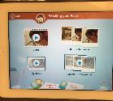

Assistive Technology – Rehab Techs
Available to all consumers of OVR service, if referred by VR Counselor
Common supports include help with memory and retention, communication, and overcoming physical barriers, as well as assistance with workflow and ergonomics.
Able to consult but also have a budget to purchase items.
Items to lend/try out, also look for KATS Network.
Could ask the Case Manager about purchases as well.

Slide 19
Who do I talk to?
Supported Employee
Supervisor
Co-workers
Family or residential staff (key people)
Obviously, you only speak to people you are allowed to speak with. If employee didn’t disclose, you do not begin to follow up with employer or co-workers.

Slide 20
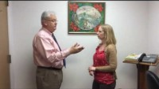
Intro example
https://youtu.be/V9vtfM6jJ78
Notes:
The video includes functional closed captions that can be turned on/off during playback. PowerPoint’s Accessibility Checker flags a missing subtitles error because it cannot detect embedded caption tracks unless a separate VTT file is attached via the Playback tab. This is a false positive; captions are present and meet WCAG 2.1 SC 1.2.2.

Slide 21
Example of Supported Employment Services – Old Navy
Rebecca is the ES, and Melissa is the Old Navy employee.
Melissa had always had someone with her on the job. When she went back after COVID began, the ES was not allowed on site at store and so they created this book.
They LEARNED she could be independent on the job with this prompt and the calls before & after work. They developed a picture-based task list for Melissa to follow with paper and electronic copies.

Slide 22
Example of Supported Employment Services – Old Navy
Previously present for each shift, and offered additional training for independent work:
Modeling
Onsite support of task completion
Clarifying roles, communication, processes
Identifying natural supports, point person for question
Communicating with residential staff about schedule, transportation, expectations
Creation of task list
Paper for in store
Electronic – on phone, computer

Slide 23
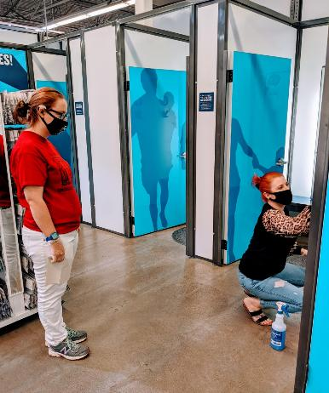
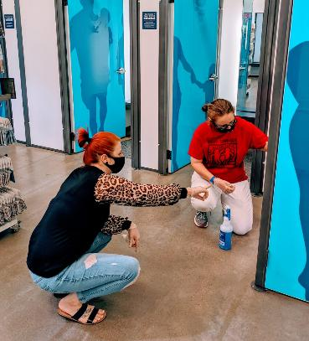
An example of Supported Employment Services –modeling & instruction

Slide 24
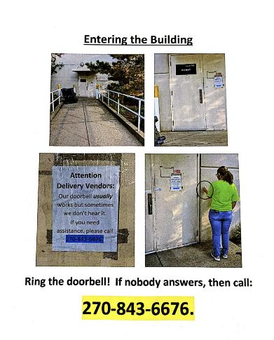

Melissa’s Picture Book – Remote Support

Slide 25
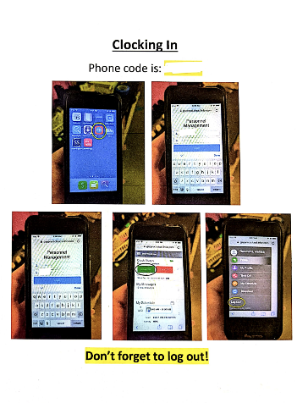
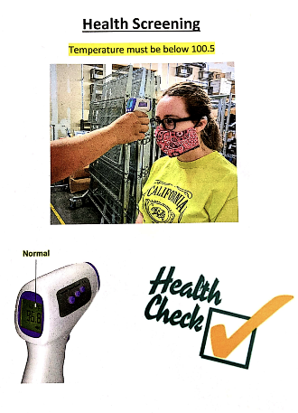
Melissa’s Picture Book – Remote Support 2

Slide 26
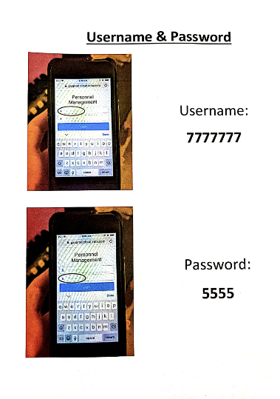

Melissa’s Picture Book – Remote Support 3

Slide 27
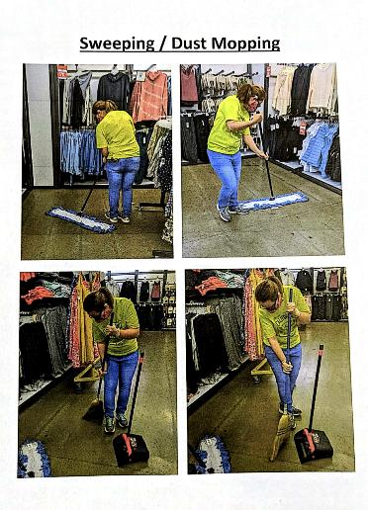
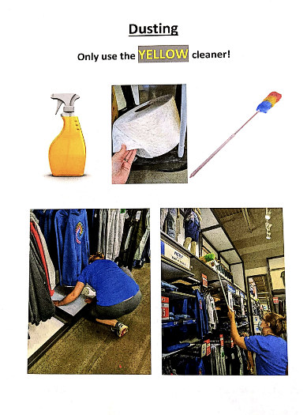
Melissa’s Picture Book – Remote Support 4

Slide 28
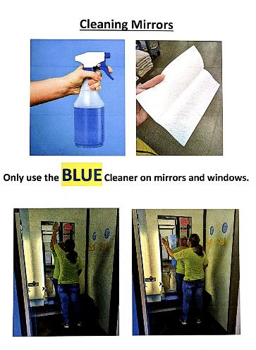
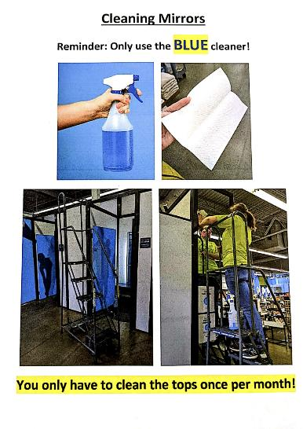
Melissa’s Picture Book – Remote Support 5

Slide 29
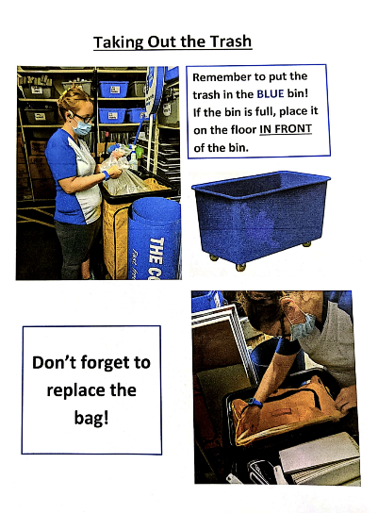
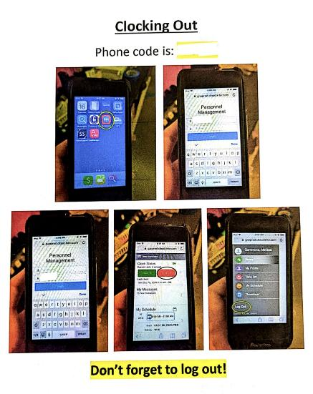
Melissa’s Picture Book – Remote Support 6

Slide 30

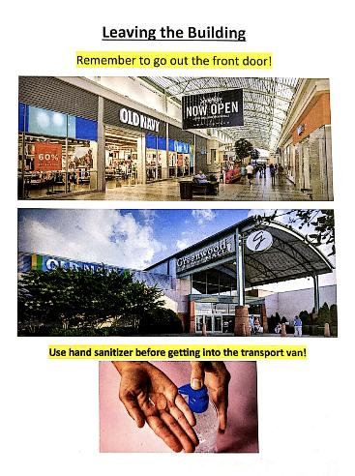
Melissa’s Picture Book – Remote Support 7

Slide 31
Example Questions to Employee as you start to fade out
Ask about specific tasks
Which files have you worked on today?
Is the calendar we set up helpful to you? Are there things that are still confusing?
Where is the date on this form?
Ask about general happenings
What is going well at work?
What is frustrating you at work?
Is Suzy still able to answer questions when you have them?

Slide 32
Supported Employment Services – OVR documentation
Receive Authorization
Monthly submit:
Supported Employment Services Note
Employment Stability Assessment
Invoice $80/hour
Intensive supported employment services, with or on behalf of consumer
Minimum 30 days up to 2 years max
This phase ENDS upon reach “stable employment”
Determined by:
Employment Stability Assessment (your end)
Approved by OVR counselor

Slide 33
Supported Employment Services Note
Basic info
Service
Onsite or Offsite
What did you provide
Feedback received from employer
What did you learn about performance/employer
How is individual achieving stability on the job
What is needed to increase independence
How are you reducing your presence on the job site
Steps to increase natural supports
Additional information/insight obtained

Slide 34
Supported Employment Services Note
At the bottom you’ll find:
If the individual has achieved stability:
Complete the Extended Services Plan
Update the Employment Stability Assessment form
Submit to the OVR Counselor

Slide 35
Employment Stability Assessment Form
Submit Monthly
Supported Employment Services Provided
Basic Information
Questions Related to Employment Stability
Yes/No
Additional info – this is a summary of SES notes
Additional Questions
Consistent with PCEP/Career Profile?
IF not, contact VRC immediately to clarify or update
Have hours increased/decreased
Has your support increased/decreased
Issues around benefits (SSI/SSDI)

Slide 36
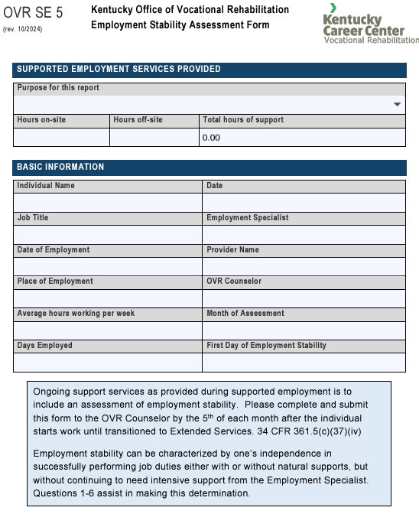
Employment Stability Assessment
Monthly Report/SES OR
Sustained Stability
IF stability has been achieved

Slide 37
Employment Stability Assessment Form – stability rating scale
Scale of 1 – 10: Gauge according to 6 questions that meet “Stable Employment’
1 = dismissed due to performance
10 = stable on the job and ready to move into Extended Services
If 9 or below
What keeps it from being higher
What is needed to reach stability
If lower than last month; why?

Slide 38
What is Stable Employment?
The individual is satisfied with employment.
The acquired job is consistent with the individual’s strengths, abilities, interests, and informed choice.
The individual’s job performance meets the expectations of the employer.
Natural supports are appropriate and in place.
All necessary accommodations are appropriate and in place.
Intensive Supported Employment Services no longer needed
Consistently answer YES to each question over time
Job meets Competitive Integrated Employment
Job is consistent with IPE (vocational goal set by VR)

Slide 39
Stable Employment
Consistently answers yes = sustained stability
Consistent successful performance
With or without natural supports
Without intensive supported employment services (you)

Slide 40
Stable Employment – move into Extended Service
Final Employment Stability Assessment may be submitted at ANY point of the month
Once approved by VR Counselor
Invoice final Supported Employment Services at $80/hour
IF consumer is 25+ years of age: hourly payments now END from OVR

Slide 41
Extended Service Plan
Submit this plan:
Day 1 of stable employment, along with final Employment Stability Assessment
Once APPROVED you can invoice for $500.00
Day 45 of stable employment
With Invoice $1,500.00
Day 90 stable employment
With Invoice $3,000.00
Summary of the supports you are providing, how employment is going for consumer

Slide 42
Extended Services Report
Submit Monthly Day 1 – 90 of Stable Employment
IF YOUTH UNDER AGE 25: you can invoice for these hours at $80/hour
If 25 years or older – you cannot invoice VR for hourly rate (you can switch to other source available)
This is showing that you are checking in at minimum of 2 times per month, at the job site
Yes, it’s called “report” but they are notes

Slide 43
Change from VR to other funding
Once your agency receives the FINAL HOURLY fee you have “exhausted funds from Vocational Rehabilitation”
If 25+ years this is upon approval of Stable Employment
If 24 or under, this is at 90 days of Extended Services and closure of case
Agency switches to Extended Services (often called Long Term Supports) funding source to support person on the job
Medicaid waiver, state general fund dollars, United Way, local court dollars, CDBG dollars, this will vary
Documentation requirements will differ by funding source – know what’s needed for each person you serve
If you have no required documentation, continue to use Extended Services Report

Slide 44
When will VR close the case?
Counselor wants to be assured the job is going well overall:
General satisfaction
Number of hours worked
Performance of job duties
Interacting with co-workers & supervisors
Other “less visible” but essential aspects of the job:
Hard to list, but if unattended, could jeopardize the worker’s future
It may be at 90 days of STABLE EMPLOYMENT
Not automatic,
Consumer driven

Slide 45
Extended Services beyond OVR dollars
Minimum expectation over term of employment
2 times per month
In person
At the job site
YES, EVEN AFTER VR CLOSES THE CASE
IF no disclosure – visit will not occur at the job site
IF the consumer does not want in person or at job site you need to document this

Slide 46
Extended Services
Make supported employment unique from other vocational services
Individualized
Pro-Active vs. Reactive
Provided throughout term of employment (the job) even AFTER VR closes the case

Slide 47
Full Example Set - JMarcum
Read over to see how each phase builds on the next
Example of how to organize information

Slide 48
IF USE MEDICAID WAIVER
K
Usually this is for long term support/extended service
BUT
For now it could be everything for new cases wait listed with OVR due to Order of Selection

Slide 49
SCL vs Michelle P.
Medicaid Waiver
SCL
Michelle P.
Any combination of day training, community access, personal assistance, or any hours of paid community employment or on-site supported employment service shall not exceed sixteen (16) hours per day.
160 fifteen (15) minute units per week for day training alone or in combination with any hours of paid community employment or on-site supported employment service. (or 40 hours)
The following Michelle P. waiver services, alone or in any combination, shall be limited to forty (40) hours per calendar week:
(a) Homemaker;
(b) Personal care;
(c) Attendant care;
(d) Supported employment;
(e) Adult day health care;
(f) Adult day training;
(g) Community living supports;
(h) Physical therapy;
(i) Occupational therapy;
(j) Speech therapy; and
(k) Behavior supports.

Slide 50
Waiver & SGF providers Coordination of Employment Services form Email form to – DDID.SupportedEmployment@ky.gov – or upload in MWMA and notify DDID.SupportedEmployment@ky.gov that it is there
See form on SE Core Training Materials page & chat box: “Coordination of Funding for SE and/or Supported Education Services-Waiver Only”
Medicaid Waiver

Slide 51

SCL - Billable Limits
Many people who qualify for waiver services may need more than 2/month check in
*Person Centered Job Selection
120 Units
*Job Development
90 Units
Long Term Supports
24 units each month (unless granted more due to approved justification)
*Job Acquisition and Stabilization
800 Units
*Requires Coordination of Funding for Employment Services form sent DDID.SupportedEmployment@ky.gov

Slide 52
Whom do I talk to?
Supported Employee
Supervisor
Co-workers
Family or residential staff (key people)
Obviously, you only speak to people you are allowed to speak with. If employee didn’t disclose, you do not begin to follow up with employer or co-workers.

Slide 53
What do I ask?
Be conversational!
This is an extension of relationship building/growing
Don’t just ask “how are things going?”

Slide 54
America’s favorite question:
How are you?
You all know the “answer”

Slide 55
What do I need to learn?
Individualized!
Is work getting done?
Does employee know what to do and where to get info if needed?
Are there parts that are a struggle or concern?
Are natural supports effective?
Is s/he seen as a valued employee?
Is s/he underutilized?

Slide 56
Example Questions to Employee
Ask about specific tasks
Which files have you worked on today?
Is the calendar we set up helpful to you? Are there things that are still confusing?
Where is the date on this form?
Ask about general happenings
What is going well at work?
What is frustrating you at work?
Is Suzy still able to answer questions when you have them?

Slide 57
Example questions to Employee
Ask about changes in the workplace
Do you understand the changes in the schedule coming next week? How will that impact your transportation?
Is there anything new that everyone is talking about?
How come I see offices with packing boxes?
Are there new tasks you would like to learn to do?
Keep things conversational; not just a list of questions

Slide 58
Example questions to Employer
Is Teresa keeping pace with other employees?
Does she know who to go to with questions?
How is it going with her using the new calendar?
Are there other tasks she could take on in her down time?
How is she handling the recent schedule changes?
Anything else going on with co-workers I should be aware of?
Are there any changes in the company coming up?
Keep things conversational; not just a list of questions.

Slide 59
Be ready to advocate
For more hours, tasks if wanted
If there are problems, be ready to help speak on behalf of employee
Not pity, but being sure expectations & communications are clear

Slide 60
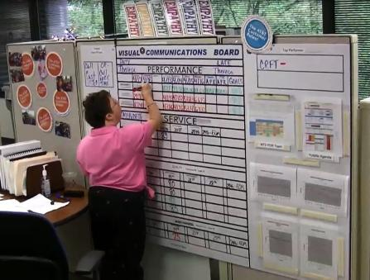
Extended Services example:
No one needed on the job; just drop in to check on things & look for new opportunities
Support her in confidence, seeing her role there
As company has changed, so have her tasks
How to learn these boards (on the job v. simulation)
Prompts – Lists, reviewing numbers, ordering tasks (boards before mail)
Helping her understand the “no talking” rule on the call center floor
Trusted conversations are possible – with her, her family, and her supervisor – and helpful

Slide 61
Don’t forget what you know
Be sure to ask things that make sense regarding that individual
Know the impact of disability on the person & this position and be aware of any concerns that arise
If you don’t find out about concerns until they are full blown problems…you’re too late!

Slide 62
Look toward the future
Just because someone is independent for a long time doesn’t mean they don’t need any support
Are there new tasks to try?
Can they get more hours?
Are they ready for a change?
Has the impact of disability changed?
Are they bored?

Slide 63
Damonte has been writing since he was a child. After receiving a bachelor’s degree in English, he knew he wanted to pursue a career in writing. He has been working as a technical writer for the past five years for a business magazine. Damonte has a mental illness and, increasingly, has times when he finds focus difficult. This is beginning to impact his ability to meet deadlines. What might you suggest as accommodations for Damonte to request from his supervisor?

Slide 64

What if no disclosure?
Call
Email
Text
If public place, pose as customer
Be in parking lot on breaks
Meet for lunch or coffee

Slide 65
Remote Supports
In addition to 2/month in person check ins.
OR if consumer has specifically requested you to not be on site.
FaceTime on the Job (with permission)
Phone calls during break
Phone calls with supervisors
Emailing tools to supervisor/co-workers that could be helpful on the job (task lists, reminders of apps s/he uses…)
FaceTime/Zoom/Google Duo after hours to debrief and go over important topics/interactions with others
Review task list via Zoom shared screen before a shift

Slide 66
Step Down Supports – OVR OPTIONAL
If need for Extended Services is less than 2 on site visits/month AND on the job one year AND in Extended Services:
Submit Step-Down Support Plan to CRP Consultant
Keep signed approval form as well as documentation supporting your timed commitments in your agency files. OVR may request at any time.
If supported employee experiences issues and needs assistance, you must provide the service immediately and remove from SDS until stable on the job for at least 6 months. New Step Down Support Agreement will need to be submitted.

Slide 67
IPS Supported Employment:
Transition to the Team
Once stable on the job, you can “transition the consumer to the team”
You will need to complete Step Down Support Plan
You will need to complete the IPS Transition Plan (for your records; not OVR)
Job End
IPS has a Job End Report you complete and keep in your own records

Slide 68
Examples of Extended Services
Visit at job site, conversation
Email
Text message
Phone call
Meet for lunch or coffee
Be present during annual evaluation

Slide 69
Look for new
People lose jobs
People want NEW jobs – new challenges, better pay, better fit
People can have a second job – add more work hours to the week without leaving a place they like
Spend time with individual
Spend time on behalf of individual
Re-apply for OVR services (new case)

Slide 70

How Do I Do It ALL?
You have to be able to organize your time
Schedule follow up visits on your calendar
If you do not plan in advance for follow up visits, they’ll get dropped – beware
Don’t let just “the squeaky wheel get the grease”

Slide 71
Remember…
Supported Employment is a support received so someone can be EMPLOYED
Employment is not a “program”- it’s a JOB
You do not have to be with the person all the time
It does not work the same for everyone

Slide 72
Employment Specialist/Job Coach: Facilitator of Integration
David Hoff, UMASS Boston

Slide 73

Whether you feel…

Slide 74

Maya Angelou Quote

