Slide 1
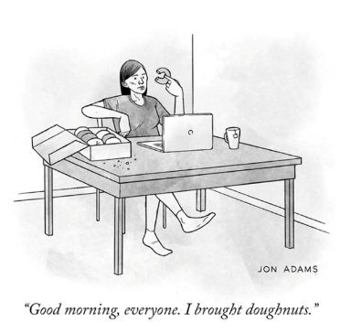
Session 1 SE Core Training Series
Job Development

Slide 2
Reviewing PCEP/Career Profile
Ask a co-worker to review your PCEP/Career Profile and see what they think of the previous questions
Ask the individual/family to review the PCEP/Career Profile and see if it sounds like you’ve captured who he/she is or if there are areas which still need exploration

Slide 3
Communication is key
Activity notes must be turned into OVR (non IPS)
PCEP should also be turned into Case Manager
IPS requires routine meetings between ES & VRC, ES & treatment team
Other SE programs should look at similar practice

Slide 4
From Discovery to Job Development
Always use the information learned about the job seeker’s interests, conditions, and contributions.
Begin with prioritized list of employers from Plan of Action/Job Search Form.
Continue to network as needed – adding (with job seeker’s permission) contacts that meet interests, conditions, and contributions.

Slide 5
All jobs found via VR must meet definition of Competitive Integrated Employment – CIE
Competitive Integrated Employment
You are paid no less than minimum wage and at least what other employees without disabilities who do similar work at that job are paid.
You are eligible for benefits and promotions like your coworkers without disabilities who do similar work.
You interact with other people without disabilities to the same extent as employees without disabilities who do similar work.

Slide 6
Two Approaches
Labor Market SE Job Development: Responding to the needs of employers with applicants who are “qualified” to meet those general needs.
Customized SE Job Development:
Discovering the “strengths, needs and interests” of applicants and negotiating a job description that meets both the applicant’s and employer’s specific needs.

Slide 7
Labor market v. customized employment
Labor Market Typical Process
Customized
Typical Process
Employer Contact
Informational Interview/Job Analysis
Application
Employment
Employer Contact
Informational Interview/Job Analysis
Presentation
Negotiation
Employment

Slide 8
Customized Employment
Currently:
Leadership Series & Certifications = Ability to bill OVR at CE Rate
BUT anyone can customize a job!

Slide 9

I just don’t know that they can…

Slide 10
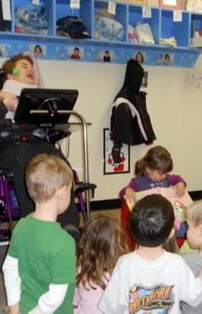
Contribution versus competition
Contribution
vs.
Competition

Slide 11
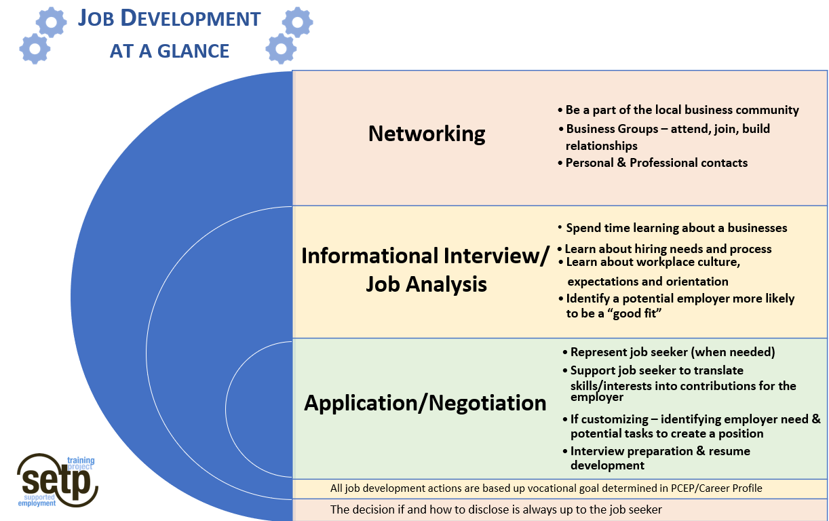
Framework for today

Slide 12
Targeted Job Development
Gives you a list for that particular job seeker.
Creates the basis for your “pitch” to an employer that makes sense.
Keeps momentum going.
Directs the network that you are trying to access.
Avoids “but we’ve put in applications everywhere in town and haven’t found anything…”

Slide 13


Businesses as Customers

Slide 14
Hidden job market
The Hidden Job Market
70 – 80+% of jobs are never advertised

Slide 15
How Employers Prefer to Hire
Referrals
Employment Agencies
Proof
Advertising
Resumes/ Applications
Employer’s Preference
Common Practice
Employment Analytics

Slide 16
Where to make contacts: the work of Job Development
Business Contacts – ES & agency
Society of Human Resource Management
Social media contacts
Business Contacts - job seeker, friends & family
OVR
Civic organizations
Workforce Innovation Board
Advocacy agencies
Professional associations
Chamber of Commerce
Coalition Forward

Slide 17
Talk to Employers in your Community
Evidence based practice shows that if you talk to 3 new employers a week, hiring rates will increase
A note about Job Development and billable hours

Slide 18
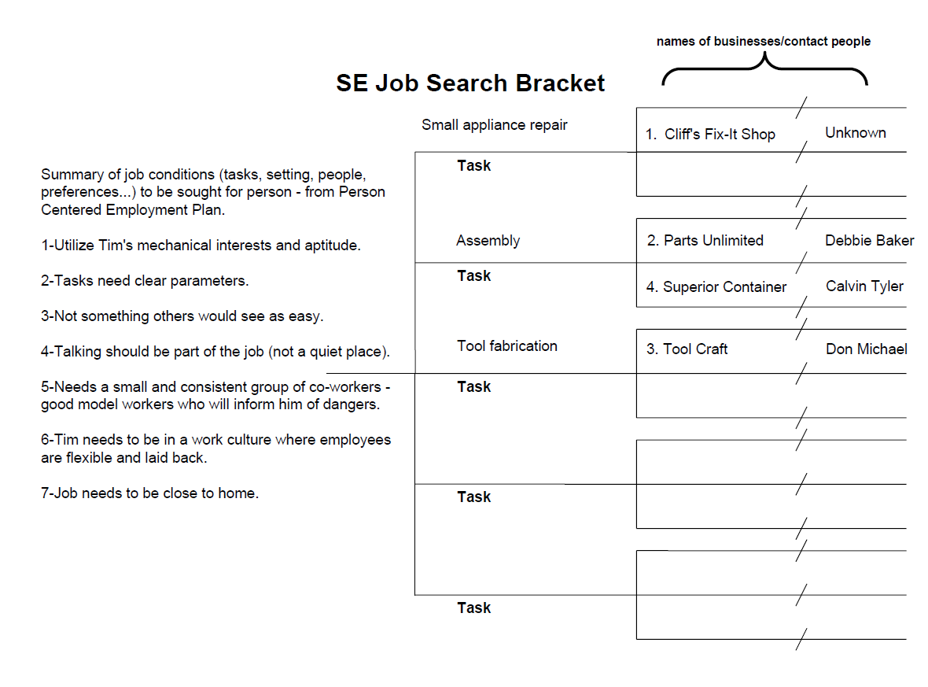
Identifying Relevant Businesses

Slide 19
Networking Ideas
Board members
Mechanic
Neighbors
Vet
Dentist
Church members
Soccer Parents
Grocery Clerk
In Laws
Beautician
Teachers
Coach

Slide 20
Where was your first job?

Slide 21
Job Search Methods Yielding Jobs (Department of Labor)
Informal 63%
Want Ads 14%
Agencies 12%
Other 11%

Slide 22
Networking
Always be ready to explain what you do. (2-3 sentences)
Get involved and participate
Listen

Slide 23
Breakout Room Activity
How do you answer the question “What do you do?” in general conversation or at a networking event?

Slide 24
Connecting what you KNOW with where to GO

Slide 25
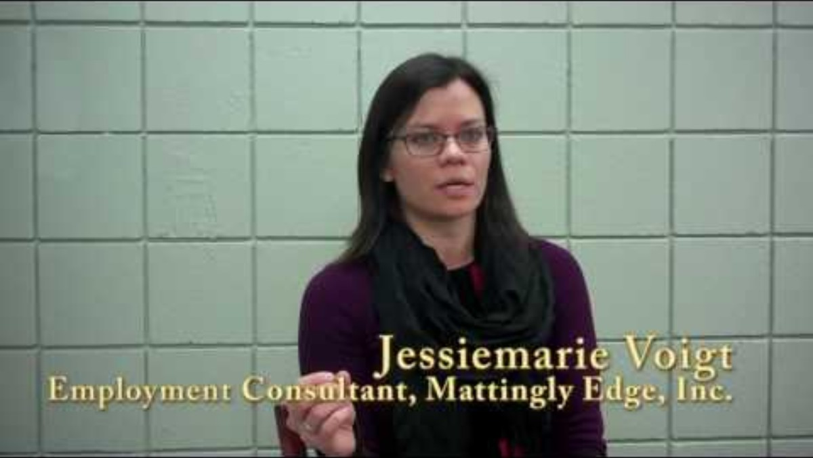
Ellie’s Customized Job
Notes:
The video includes functional closed captions that can be turned on/off during playback. PowerPoint’s Accessibility Checker flags a missing subtitles error because it cannot detect embedded caption tracks unless a separate VTT file is attached via the Playback tab. This is a false positive; captions are present and meet WCAG 2.1 SC 1.2.2.

Slide 26
Ellie & the Why’s of where to go
Wide variety of tasks and opportunities
She had really strong memories of YMCA activities from her childhood
Employees get a free membership & she was excited about the possibilities of this perk!
Looking for businesses on TARC 3 route (transportation)
Looking for place where the culture is to look out for each other
“Membership” culture/value was important – among staff & Y members
Listening to an openness to new ideas
Possibility of being around lots of people – social interaction

Slide 27
Megan’s Story
https://independenceplaceky.org/
https://vimeo.com/272830635

Slide 28
Megan & the Why’s of where to go
She loves to bake
Being busy & focused helps to keep the symptoms at bay. This is a busy bakery/catering company.
Small business and ES could talk directly to the owner about her business and hiring needs
There is plenty of work to do, ES had belief that she would be valued for her work/contribution
Local business
Sarah: “Megan is passionate about baking” Business Owner: “Well, I need some of that!”

Slide 29
Conversation starters
Where do you find or recruit employees?
Creates an opportunity to discuss the service you provide
How are people trained in their job?
Offers you information about natural training means & methods that can be used in assessing job match & training plan
What are the prerequisites for working here? How or where do your employees gain the experience required to work here?
What personal characteristics do you look for in employees?
Offers tips to highlight in a resume or interview; offers glimpse of culture & what is valued
Gets deeper into qualifications, offers additional insight than standard list of requirements, and may include list of similar companies

Slide 30
Leading Questions – Customized Employment
Can you tell me about your business, the products, & services?
What is most important to your company?
What types of work are done here?
What about additional tasks - things that happen when people have time to do them?
What happens when those things don’t happen as needed?
Are there tasks that you need to be completed more efficiently or timely?
Can we talk about ways my client might contribute to your company in a manner I think you’ll find very useful? (If already mentioned now talk about the client & what s/he could contribute).
Could I set up a time to tour your business and also see these tasks more in depth? (If no tasks mentioned, then begin with general tour to further the conversation).

Slide 31
Leading Questions – Labor Market
What type of work do you do here?
What’s most important to your company?
What skill sets do you look for when hiring? What about experience & education?
What openings do you have now? Do you foresee other openings in the near future?
What is your hiring process?

Slide 32
Some thoughts on marketing/sharing your message

Slide 33
Quietly Sharing your Values and Role:
Professional
Says “Employment Service”
No Sympathy or Charity
Respectful and Dignified

Slide 34
What’s in a name?
Job Coach, OR
Employment Specialist
Career Coordinator
Employment Recruiter
Business Liaison
Employment Facilitator
Employment Consultant
Does your job title:
Provide clarity and understanding about your role?
Cause confusion about what you do and people you serve?

Slide 35

Marketing Tools
Brochures
Business Cards
Fact Sheets
Social Media presence
Newsletter
Media

Slide 36

Newsletter examples:

Slide 37
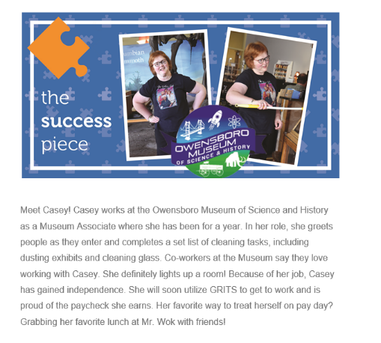
Casey

Slide 38
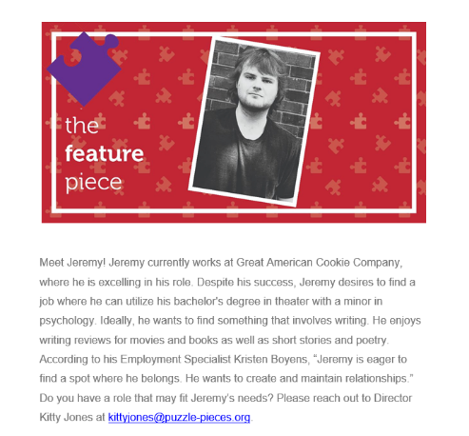
Jeremy

Slide 39

Logos & slogans
Professional? Says Employment Service?
No Sympathy or Charity? Respectful and Dignified?

Slide 40

Logos & Slogans Continued…
Professional? Says Employment Service?
No Sympathy or Charity? Respectful and Dignified?

Slide 41
Photographs
This is your one chance to show “a job for a person with a disability.”
Show people working.
Avoid cheesy shots.
Choose the picture on its own merits, not the story.

Slide 42
Language
Job Development – Recruitment Assistance
Job Coaching – Retention Support
Follow-Along – Post-hire Support
Consumer – Applicants, Job Seekers
Supported Employment – (simply) Employment

Slide 43
Language Continued…
You are talking to businesses – keep human service language out of it.
ADT, TRP, Staffed Residence, CLS, E&R, Community Access, DSP…
“In the community”

Slide 44

Personal Presentation
Dress in line with the industry/business or a step above
Ensure your email address & voicemail are professional
Conduct yourself in a manner appropriate for the business
Be yourself and remember you are making an impression on behalf of the job seeker and your agency
https://www.coursera.org/articles/what-to-wear-to-an-interview

Slide 45
“What kills a skunk is the publicity it gives itself.” Abraham Lincoln

Slide 46
Informational Interviews
A way to get in the door:
Gaining relevant info about nature of work, while
thinking about possibilities, and
WITHOUT the pressure (on employer or on you) that’s often present when making a job development call.
May take place during Discovery or job development.

Slide 47
Informational Interview Template
See handout – Cary Griffin – “Informational Interview Template”
“Most folks love to talk about their business and since you are not pressing them, a tour is considered low-risk.”
See Informational Interview Template on SE Core Training Materials page (Session 1 / Day 2)

Slide 48
Informational Interviews Are…
A casual conversation with a prospective employer at the monthly Chamber of Commerce “Business After Hours” social or at a service club meeting (e.g., Kiwanis, Rotary, Lions, et al.) can lead to a probe such as…
Cary Griffin

Slide 49
Or…
“I’ve never seen your operation before. Would you mind if I called you to set up a time for a tour and a bit of a chat? I am working on a career plan with a young woman right now who has an interest in your industry, perhaps you could give her some career advice and suggest her next steps?”
Cary Griffin

Slide 50
Informational Interviews Reminders
Generally, a request for fifteen to thirty minutes works well because it signals respect for the person’s time, and it indicates that you are busy as well.
Experience shows that fifteen minutes may become thirty to sixty minutes once the discussion and tour begins.
Cary Griffin

Slide 51
Informational Interviews – How To
General format:
Brief Discussion - “Before we tour, can you tell us a bit about the history of the business, the products and services, and how the business is evolving?” And “Tell us how you got into this line of work.”
People want to know that you care, so give them a chance to talk about themselves.
Cary Griffin

Slide 52
Informational Interviews - How To
General format:
Tour, with questions asked by the job seeker (if present) and the employment specialist at appropriate times and of various people performing the many tasks along the way.
Cary Griffin

Slide 53
Informational Interviews - How To Continued
General format:
Wrap-up by thanking the people for their time and ask for any advice they have for the career plan, other businesses that should be visited (ask for a referral!), etc. Make your exit and promise to stay in touch.
Cary Griffin

Slide 54
Smooth Listening
Remember: We are not the experts on their business!
Listen more than you talk.
We are merely looking for advice.
Don’t use personal stories or wind up talking about yourself or what you do.
Ask open-ended questions with an emphasis on the job seeker.
“What advice would you have for someone trying to start out in your field?”
Patty Cassidy

Slide 55
Example of Info Gained What more can you ask? What possibilities can you see?
Shipment comes three times a week – we can’t get in the room for the two days after.
I have office people doing physical inventory.
The office is a mess. Look at all these catalogs we get.
The website orders were just given to my department. We don’t have anyone to process these orders.
Inventory is around the corner, I’m afraid to even open the door as it’s a mess.
Adapted from TransCen

Slide 56
Breakout Rooms - Activity
Download – Human service to business language
Discuss:
How can using business language when doing job development change the way employers respond to you?
How do you connect with your local business community?
How do you/could you conduct research ahead of job development meetings?
How often do you have set meetings with employers?

Slide 57

Organizing Employer Information – Your Agency
Log of employer visits via shared drive OR
Apps that store info along with mapping capabilities.
Keeps your agency on the same page.
Supervisors – Check these weekly!
Ask why? What did you learn?
Give you a spot check on activity.

Slide 58
Keeping track of employers
Keep a log! Plan re-contacts by marking them on your calendar.
Ralph’s Construction phone 323-4697 EMAIL ralph@biz.net
Date
Contact person
Type of contact
Notes
10/26/24
Ralph Smith
call
Called Mr. Smith to request an appointment to talk about office work for Sally D.
11/12/24
Ralph
visit
Discussed data entry job for Sally D. Will call to follow up in a few days.
11/15/24
Ralph
call
Set a time to begin job analysis for data entry.

Slide 59
Activity – Where would you go? Have someone ready to keep a list so each group has a count of business names listed – specific names (i.e., not just car dealer.)
Breakout Rooms

Slide 60
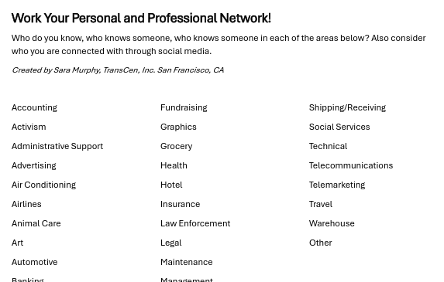
Contact List By Industry
Not required but a way for you, or your team, to brainstorm who you know for informational interviews/research of local industries.
You can find this on the SE Core Training Materials page (Session 1/Day 2)

Slide 61
Representational Considerations:
Know your role & what you can say BEFORE you talk to an employer with/on behalf of someone.

Slide 62
Supported Employment allows for a wide range of representation You’ll need to discuss your role – and what you can say - before making contact with employers
Person needs minimal assistance
Person needs significant assistance
Encouragement
Support on the side
Rehearse strategies
ES explores fitting possibilities
ES performs job analysis
ES orchestrates the shape of the interview

Slide 63
Robert
Informational Interviews - ES
Online Applications - Robert/ES
Interviews - Robert
Hired as computer technician. Even has company car!
Robert and ES initially got together once a week outside of work. Now after 2 years, they still communicate through email. Employer not aware of supports by ES.

Slide 64

Tim
Propose Customized Job
Orchestrate Interview
Facilitate Natural Supports

Slide 65
Representational Strategies
Representational Considerations Form – Randy
You can find this on the SE Core Training Materials page: OVR Documentation & Process / Traditional SE Documentation Example Sets

Slide 66
Audio/Video Check In!
What’s your favorite Thanksgiving dessert?

Slide 67
ADA (Americans with Disabilities Act)
Key ADA components
Qualified candidate
Essential functions
Reasonable accommodations
Undue hardship
Disclosure
http://www.adasoutheast.org/ OR
1-800-949-4232

Slide 68
Disclosure
Individuals seeking work are not required to disclose their disability. However, without disclosure the employer is not obligated to provide reasonable accommodation.
There are no “right times” to disclose a disability; however, most employers will have positive feelings for someone who is forthcoming with information.

Slide 69
Disclosure Continued…
Effective disclosure focuses on needs and provides practical suggestions for reasonable job accommodations if needed;
Disclosure should be disability specific rather than general; for instance, how the disability affects someone’s ability to perform a task;
What types of accommodations have worked in the past;
What accommodation is anticipated?

Slide 70
Under the ADA a person disclosing a disability has the right to:
Confidential
Have information about their disability treated confidentially and respectfully;
Seek
Seek information about hiring practices from any organization;
Choose
Choose to disclose a disability at any time during the employment process;
Receive
Receive reasonable accommodations for an interview;
Be
Be considered for a position based on your skill and merit; and
Respect
Respectful questioning about your disability for the purpose of determining what accommodations are needed.

Slide 71
Specifics per Disability & Questions/ADA Info
EEOC Disability Discrimination page:
https://www.eeoc.gov/laws/types/disability.cfm (this page has examples in addition to the 2 below)
Examples around Intellectual Disability:
https://www.eeoc.gov/laws/types/intellectual_disabilities.cfm
Examples around Mental Health:
https://www.eeoc.gov/eeoc/publications/mentalhealth.cfm

Slide 72
Accommodation/Workplace Support Ideas
Job Accommodation Network (JAN)
askjan.org
Sample accommodation letter:
https://askjan.org/media/AccommRequestLtr.cfm
And more at askjan.org!

Slide 73
Embracing the Rules of Sale
Preparing for employer meetings

Slide 74
Embracing the “Rules of Sales” – Employer Contacts
Make appointments first. We should never make a presentation without first establishing an employer’s interest in hearing it.
Time is the most important commodity of business. We’ve got to minimize the time we require of employers.
Use the language of business. We must strive to identify and use business-focused language instead of human service jargon.

Slide 75
Qualifying Your Contacts
The first step in engaging employers starts with getting to know the applicant. “Who is the person?”
By carefully answering this question, we have a way to explain to employers the reason for contacting them.
In sales terms, this is qualifying your contacts.
Marc Gold & Associates

Slide 76
Non-negotiables
Non-negotiables are those aspects of a negotiation that you or the job seeker are not willing to bend on. It is critical that you plan for these in advance and find gentle ways to explain to the employer why you’re not able to negotiate on those items.
Marc Gold & Associates

Slide 77
Examples of Non-Negotiables
Evening hours
Not in an open floor plan
Accessible space
Sub-minimum wages
Assuring production
Providing a substitute worker for supported employee
Assuring ongoing transportation
Anything illegal
Charity relationship

Slide 78
Outline for an Initial Presentation
1. Introductions
2. Why you are here
3. How we do what we do
4. Introduce applicant represented
5. Close the initial presentation
Marc Gold & Associates

Slide 79
Employer presentation outline 1
1. Introductions
Introduce yourself -- business card, referrals
Introduce your agency -- brochure, fact sheets
2. Why you are here
“We match applicant skills with employer needs”
Marc Gold & Associates

Slide 80
Outline for an Initial Presentation 2
3. How we do what we do
Explain the discovery process, job search plan, and retention strategies offered after hiring.
4. Introduce applicant represented
Explain the skills/contributions of the applicant.
Marc Gold & Associates

Slide 81
Outline for an Initial Presentation 3
5. Close the initial presentation
Ask for an opportunity to return for additional discussions and a tour of the business.
Marc Gold & Associates

Slide 82
Initial Contact…
This...
Hello, my name is Joe, and I work for Happy Hearts Jobs. We are a supported employment provider and help people with disabilities gain meaningful and productive employment in the community. I was wondering if you have any openings?
Or This….
Hello, my name is Joe, and I work for Employment Solutions. We are an employment agency that provides area businesses with recruitment assistance and retention support. Much of our success comes from learning about our customer’s hiring needs and expectations. I would love to get 20 or 30 minutes of your time to learn more about your business…would you have some time next week to meet?

Slide 83
Features & Benefits & USP
Be prepared with information to share!
Feature:
Recruitment Assistance
Benefits:
We provide you assistance finding quality applicants
Reduce costs for recruiting and advertising
Our employment agency takes the time to learn about your company to understand your hiring needs and qualifications to help make the best possible job matches
Unique Selling Proposition:
Ultimately, knowing your needs and expectations paired with the extensive knowledge about our candidates helps take most of the guesswork out of hiring.
Derived from Employment Analytics

Slide 84

Video 1
Job Development scenarios to critique, full video found at https://youtu.be/w0B8x4yEcDo
Notes:
The embedded video includes closed captions that can be toggled on/off during playback and are synchronized with spoken content. PowerPoint’s Accessibility Checker flags “Missing audio or video subtitles” because the captions are embedded in the video file and cannot be managed via Playback → Insert Captions. This is a false positive; user-facing captions are present and functional.

Slide 85
How did Galen do? (Part 1)
What things would you not do that Galen did, and why would you not do these things?

Slide 86
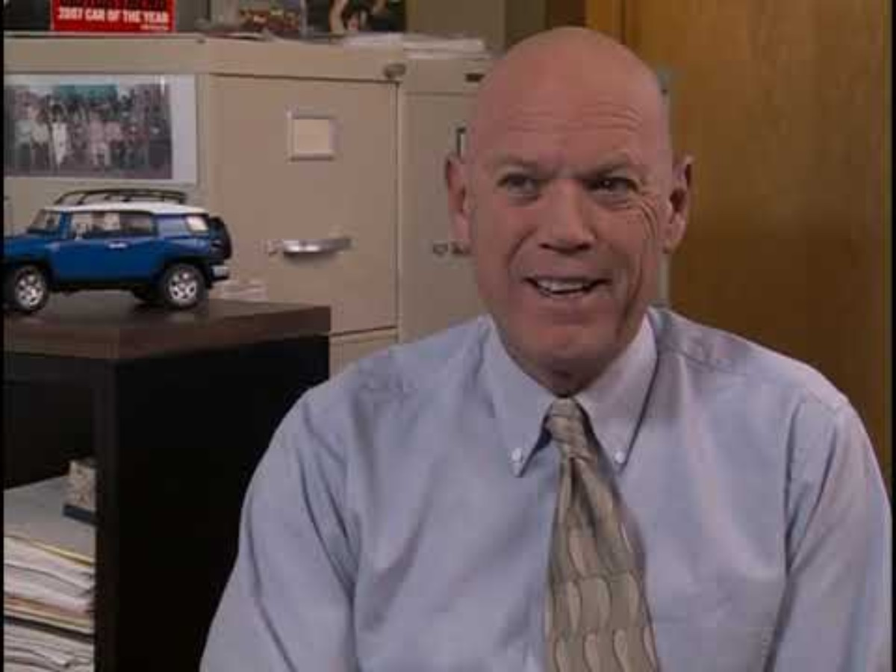
Video 2
Notes:
The embedded video includes closed captions that can be toggled on/off during playback and are synchronized with spoken content. PowerPoint’s Accessibility Checker flags “Missing audio or video subtitles” because the captions are embedded in the video file and cannot be managed via Playback → Insert Captions. This is a false positive; user-facing captions are present and functional.

Slide 87
How did Galen do? (Part 2)
What things would you not do that Galen did, and why would you not do these things?

Slide 88
And if you are not going in with someone…
Help Job Seeker prepare to ask the questions discussed previously
Know how the business accepts applications
Learn what you can about the business to help them prepare (personality, culture – check online, look at their social media, etc.)
Remember – If YOU do an informational interview, you can gain lots of info to share with the job seeker even if they will NEVER disclose they know you

Slide 89
JD documentation
Documentation of Job Development Activities

Slide 90
Documentation of Job Development Activities (Part 1)
After OVR approval of the PCEP/Career profile you will receive authorization to begin the Job Development Process.
Document each activity/meeting with “Job Development Notes.”
Remember! These activities should come from the PCEP/Career Profile-Job Search Form. Now that you know the individual’s interests and skills, you can really delve into specific employment opportunities. Your initial contact list can come from the Job Search Bracket.

Slide 91
Documentation of Job Development Activities (Part 2)
Complete one note per activity.
Billable hours include time spent with or directly on behalf of the consumer
Submit all notes to your OVR Counselor at the end of each month.
Must be turned in monthly – even if no contact was made. Create a note of attempts to contact, etc.
These notes reflect what you are doing to find a job that fits what you have learned about the individual.

Slide 92
Documentation of Job Development Activities (Part 3)
Basic Information:
Vocational Goal:
Job Development Activity:
Results:
Does this activity end with securing employment?
Is the individual still satisfied with their vocational goal?
Does the vocational goal need to be amended & if so why?
Next Steps:

Slide 93
Vocational Goal
This should relate back to what you stated in the PCEP/Career Profile.
Should tie in with the vocational goal identified by the VR Counselor (IPE – Individualized Plan for Employment).
It’s a way to be sure your job development stays in line with the employment goals/interest areas identified during PCJS/Career Profile.
The questions at the bottom of the note are to check in that this is still the goal. If it needs to change you need to contact the VR Counselor ASAP. Within 2 days of submitting the note at latest.

Slide 94
Job Development Activity
This can be at a potential place of employment (What business? With whom did you talk? Were you representing the job seeker, or did he/she participate? Did you conduct a job analysis?)
OR Other job development activity not at a potential employer (resume writing, interview prep, rehabilitation technology referral, etc.)

Slide 95
Results
What did you learn about: job seeker, potential employer, employment site, and/or resource?
What did you learn about the type of work done in this company? The culture of the company? The people?
How does this potential job site match (or differ from) the job seeker’s interests, skills, and preferred characteristics of a job?
Did you notice any unmet need within the company? Is there a possibility for customized employment? Explain what you learned and/or want to explore further.
If the activity was not on a job site, then what did you learn from the activity?

Slide 96
Next Steps
What would you like to learn more about?
When & where will the next activity take place?
Be descriptive
Make sure you follow through
Set timelines
Or if things go really well with an employer…

Slide 97
Employer Negotiation
If all parties are interested, agree on…
Tasks and expectations
Schedule
Pay and benefits
Support expectations from SE
Make sure everyone is in agreement (guardianship) before committing to anything!

Slide 98
Got a Job! Job Acquisition Report
Submit the Job Acquisition Report as soon as you know a start date and enough information to complete the form
Basic Information
Contact Info
Number of hours to be worked monthly
Estimated hours needed monthly for on & off site supports
So VR Counselor can create authorization for Supported Employment Services in time for Day 1 on the job!

Slide 99
Job Acquisition Report continued
Employment Information
Start Date
Schedule
Wage
Does this qualify for a CRP Bonus Payment?
If making $15.09/hour or more you can bill a bonus payment during Extended Services
Employer information
Job description
Does it match IPE & interests?
Employer benefits? Watch for Health Insurance bonus!

Slide 100
Job Acquisition Report cont.
What on-site supports do you plan to provide?
What off-site supports do you plan to provide?
How do you plan to identify natural supports?
Other important information

Slide 101
When to submit Job Acquisition Report?
Submit as soon as you know this information
This way the VR Counselor knows how many hours to authorize for Supported Employment Services so you can bill for the upcoming on-the-job supports

Slide 102
Job Development Invoice
Submit invoice once they START the job:
$800 if start date is within 60 days of the begin service date on authorization
$400 is start date is 61+ days of the begin service date on authorization

