Slide 1

Supported Employment Core Training Series
Session 1 – Zoom Days

Slide 2
Quick History
SE as one response to:
Patterns of congregation and segregation
Low expectations
“Readiness” trap

Slide 3
Mental Health System
1955 – Fountain House began Transitional Employment for people with SMI (1st Clubhouse Model)
2005 - Substance Abuse and Mental Health Services Administration (SAMHSA) study found supported employment to be the most effective approach for securing employment for people with psychiatric disabilities
2010 - Kentucky secured the Dartmouth Supported Employment Project (now IPS)
Still serves only about 1% of those who receive state mental health services (1.7% nationwide)
Day treatment continues to be the norm

Slide 4
Creation of the “Readiness Model” 1950s – 1960s
Day Activity Center
Sheltered Workshop
Work Activity Center
Job

Slide 5



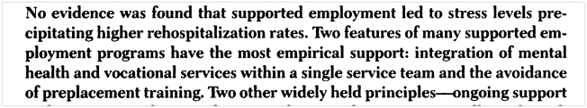
Journal article images

Slide 6
Who’s not ready?
The question that initiated our SE movement.

Slide 7

Marc Gold & 1960s – 1970s history
As a Special Educator in the 1960s he realized….
His students with severe disabilities had much more potential than anyone realized;
All people with disabilities should have the opportunity to live their lives much like everyone else; and
Everyone can learn if we can figure out how to teach them.

Slide 8
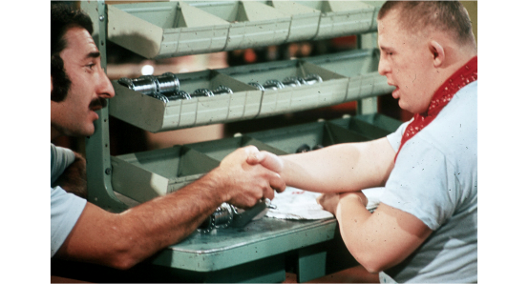
Teach; Don’t Test
“A lack of learning in any particular situation should be first interpreted as an inappropriate or insufficient use of teaching strategy, rather than an inability on the part of the learner.”

Slide 9
Competence/Deviance Hypothesis
“The more competence an individual has, the more deviance [difference perceived in a negative way] will be tolerated in that person by others.”

Slide 10
Seeking Competence
What brings out the competence in this person? What context brings out the intelligence…the gentleness…the adaptive behavior…the work skill…the good housekeeper…the conscientiousness—what context in the way of places, what context in the way of people, what context in the way of task activity, what context in the way of things to look forward to, what context in the way of role expectations? And, having discerned what brings out the best in this person, our task in service goes on to asking the question, how can we do more of that?
from Jake Yates reflections about Marc Gold, “On-the-road update," July 1992, Jack Pealer's "Safeguards Letter"

Slide 11
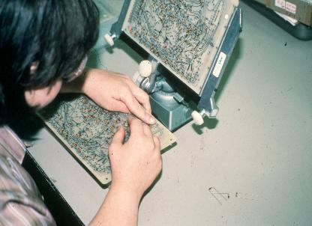

1970s Shelly assembled circuit boards
Marc Gold & Associates
Led to the “workstation in industry” or “enclave” model of employment services

Slide 12
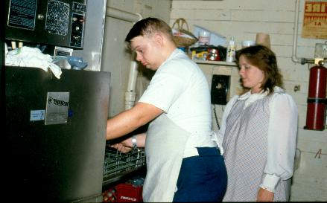
1980s Early Supported Employment Job Coach/Job Placement Model

Slide 13
1990s Individualized Job Search Planning
Strengths
Conditions
Interests
Job Search
Person Centered Job Selection became required part of SE in Kentucky in early 2000s

Slide 14
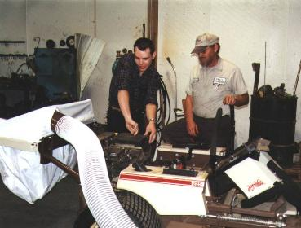

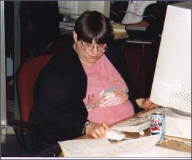
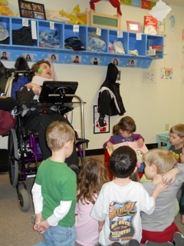
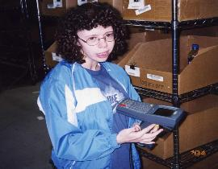
Personalized Jobs (beyond “job placement”)
Bryan & Larry
Stephanie & Jodi
LeAnn
Mallory
Shelly

Slide 15
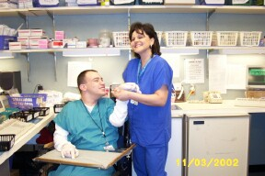
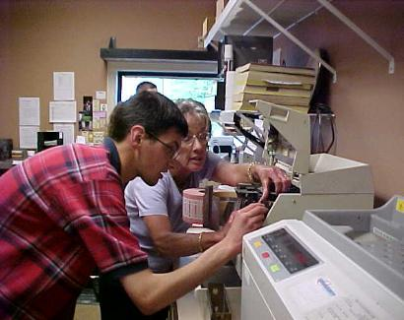
ES as bridge
Employment Specialist serves as a “bridge” to typical support
Job Analysis
Natural Supports

Slide 16
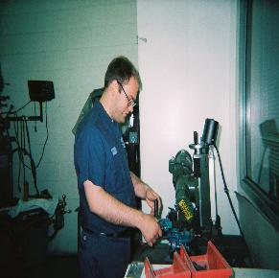
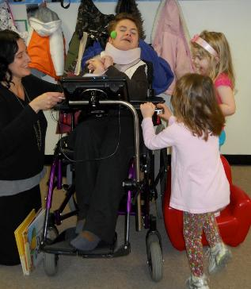

2000s
Beyond labor market job development
Customized Employment

Slide 17




Toyota 2024 vs. 1989
2026
1989

Slide 18

Employment first KY
“It is the policy of the Commonwealth of Kentucky that competitive integrated employment in the community shall be considered the first and primary option for persons with disabilities of working age who desire to become employed.”
Signed into law March 24, 2022
Executive Orders: 2018, 2020

Slide 19
All jobs found via VR must meet definition of Competitive Integrated Employment – CIE
You are paid no less than minimum wage and at least what other employees without disabilities who do similar work at that job are paid.
You are eligible for benefits and promotions like your coworkers without disabilities who do similar work.
You interact with other people without disabilities to the same extent as employees without disabilities who do similar work.
2014 – WIOA
Work Innovation Opportunities Act

Slide 20
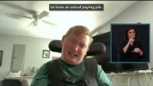
E1 video
Notes:
The embedded video includes functional closed captions that can be toggled on/off in Slide Show mode. The Accessibility Checker flags this item because captions are embedded in the video rather than attached as a separate caption file.

Slide 21

How you do your work matters

Slide 22
OVR - Refresher
EVERYONE starts Supported Employment as a consumer of the Office of Vocational Rehabilitation
Yes, people can be clients of multiple agencies at the same time
(Yes, that might get confusing but hang in there…)

Slide 23
Order of Selection – as of May 14, 2025 https://kcc.ky.gov/Vocational-Rehabilitation/Pages/Order-Of-Selection.aspx
When a state VR agency is in Order of Selection, not everyone eligible will be able to receive services
Encourage people to apply, go through eligibility and be put on the wait list, so they can be served more quickly once services resume
Being moved from the wait list is based upon Priority Category and date of application

Slide 24
Order of Selection
If a consumer has a signed IPE – Individual Plan for Employment – in place prior to May 14, 2025 they will receive services, no changes
IF someone has a Medicaid waiver (that provides supported employment) the waiver may cover all SE costs while VR is closed to that Category under Order of Selection
Email Coordination of Funding for Employment Services form to DDID.SupportedEmployment@ky.gov

Slide 25
SE Phases of Service
Link in chat
OVR Documentation & Process section of the SE Core Training Materials page
Process Flier for OVR Supported Employment:
Services
Documentation
Invoicing

Slide 26
Sequence of services – billing OVR DISCOVERY
Person Centered Job Selection (PCJS)/Career Profile:
DISCOVERY! Who is this person? What are characteristics of a good job for him/her?
Traditional:
$80/hour (10-20 hours)
Time spent directly with or on behalf of consumer
PCEP Activity Notes submitted monthly
$800 for PCEP within 45 days of begin service date
$400 for PCEP 46+ days of begin service date
IPS:
$750 for Career Profile and Job Search plan
Career Profile expected within 15 business days

Slide 27
Sequence of services – billing OVR Job Development
Job Development & Acquisition: Using info from PCEP/Career Profile. Not just filling out applications! Making connections, info interviews, etc. Job Analysis: What’s it really like in this business? How do people typically learn their jobs?
Job Development Activities
Bill $80/hour up to 30 hours max
Time spent directly with or on behalf of consumer in job development
Job Acquisition Report
Submit as soon as you know the information
Job Development Outcome Invoice
Bill $800 if start date within 60 days of begin service date
Bill $400 if start date 60+ days of begin service date

Slide 28
Sequence of services – billing OVR Supported Employment Services
Supported Employment Services (intensive) Starting the job, facilitating relationships, learning the tasks, setting up supports, etc.
Bill $80/hour minimum 30 days/maximum 2 years
Intensive supports to assist the supported employee to reach “stable employment”
Monthly submit Employment Stability Assessment
This gauges how the person is progressing toward stable employment
NEW

Slide 29
Stable Employment – How do you know?
Competitive integrated employment is achieved.
The individual is satisfied with employment.
The acquired job is consistent with the individual’s strengths, abilities, interests, and informed choice.
The individual’s job performance meets the expectations of the employer.
Natural supports are appropriate and in place
All necessary accommodations are appropriate and in place.

Slide 30
Stable Employment - documentation
Notes recorded on Supported Employment Services Note.
Employment Stability Assessment includes a measure of Stable Employment
Once you determine the consumer is stable:
Submit final Employment Stability Assessment
Submit Extended Service Plan
This will include your plan for Extended Services & allows the Counselor to issue authorization for the Day 1 Stable Employment Outcome payment

Slide 31
Stable Employment - Payments
Submit Extended Services Plan along with:
Day 1 bill $500
this payment will happen AFTER the VRC approves the Day 1 Extended Service Plan/final Employment Stability Assessment and sends you an authorization
Day 45 bill $1500
Day 90 bill $3000
The CLOCK for outcome payments starts once the consumer is in “stable employment” NOT when they begin the job
NEW

Slide 32
Extended Services
How’s it going? Where do we go from here?
Provided throughout the term of employment (entire time they are at that job)
Not intensive like Supported Employment Services
More Check in & helping more if needed occasionally
Minimum Expectation = 2 times per month in person
IF YOUTH WITH A DISABILITY (under age 25)
Bill $80/hour twice a month until VR closes the case

Slide 33
Closing the VR Case
VR will close the case once successful in STABLE EMPLOYMENT for 90 days
Supported Employment is a Long-Term Service
VR will no longer give you money once the case closes
Your agency IS EXPECTED to continue Extended Services through the term of Employment

Slide 34
Wait, what?
Yes, VR dollars end
Yes, someone can REAPPLY for VR services in the future if they need another job
Yes, IF someone has a Medicaid waiver your agency can bill supported employment AFTER you are finished billing hourly payments to VR
More on this on Day 3

Slide 35
VR expectations
All vendors (agencies) of SE need to accept at least 5 new referrals per year
All SE staff must receive 15 hours of Continuing Education each year, July 1 – June 30. (Unless staff has CRC, CESP or Marc Gold & Assoc. Certification)
4 of the 15 must be in the area of Deaf, Deaf/Blind or Low Vision
Any questions/issues may be addressed with your CRP Consultant

Slide 36
Administration tips & Documentation
Know who turns in paperwork & invoices to VR
Central billing/admin person
Individual ES
Supervisors –
KNOW what is being turned in
Review paperwork ahead of time for quality & content

Slide 37
Additional programs that provide supported employment
Do you provide waiver services?
1915c Medicaid Waivers
SCL, MPW, ABI
Intended to serve people who would otherwise qualify for ICFMR level care (institutional) in the community
IPS Supported Employment
Evidence based model, primarily serving people with Serious Mental Illness and/or Substance Abuse issues

Slide 38
Waiver supported employment
When it comes to SE, waivers pay the Extended Services/Long Term Supports portion AFTER client has exhausted hourly SE funds from OVR.
The goal is independence on the job
Must be on the service plan
The regulations & billing amounts are different for these waivers, so it is important to know WHICH waiver a job seeker receives

Slide 39
IPS Supported Employment*
IPS Supported Employment helps people with serious mental illness/substance abuse** get and keep the type of jobs they want.
*AKA: Individualized Placement & Support
**Qualifying conditions depend upon your agency’s agreement to provide IPS

Slide 40
Unique Features of IPS Supported Employment
Job Search starts within 30 days
One Employment Specialist to 20 people
65% of ES time must be spent in the community (networking, job development, Career Profile activities, follow up – NOT in office)
6 face to face employer contacts/week
Employment Specialists are full members of mental health treatment team
Transition Supports/Step Down Supports
Fidelity Scale

Slide 41
Supported Employment
The principles taught in this Core Training Series apply to all SE - regardless of the funding source or other services received.

Slide 42
Bigger than Kentucky
Best Practice in our field
https://apse.org/wp-content/uploads/2019/03/Apse-universal-Comps-FINAL3-15-19.pdf
Direct link to Universal Employment Competencies

Slide 43
Find help
“If you think work is stressful you should try unemployment”
Joe Marrone
See SE Core Training Materials: Supported Employment Kentucky Contact Info.

Slide 44
Supported Employment Phases
Discovery: Skills, preferences, support needs & ideal characteristics of a workplace
Job Development:
Networking, Informational Interviews, application process
Supported Employment Services:
Orientation, connection to natural support, training support & increase independence
Extended Services: Checking in, maintaining stable employment

Slide 45
Why do PCJS/Career Profile? Discovery Phase
This is Kentucky OVR’s assessment/evaluation for those receiving Supported Employment
We know that standardized work evaluations tell us what people with significant disabilities can’t do – this allows us to figure out what people can do
There’s more to SE than just asking, “what do you want to do?”
Note: Standardized Vocational Evaluations do NOT count as Discovery/PCJS/Career Profile

Slide 46
Principles
Concept that EVERY person has strengths
“presume competence”
Way to break past preconceived notions
Discovers new job ideas
Looks at all aspects of the person’s life
skills, interests, support needs, etc.
Prepares for focused job development

Slide 47
All jobs not equal
All Jobs are Not Created Equal.

Slide 48
Bell curve
LESS
COMMON,
AND
NEGATIVELY
VALUED
LESS
COMMON,
BUT
HIGHLY
VALUED
STATISTICALLY
COMMON
TYPICAL
PREVALENT
SEEKING THE MOST VALUED OPTIONS
(From Wolfensberger and Thomas, 1983)

Slide 49
Remember the ultimate goal: a good job
Clarity of Ideas
I am here, talking to you, because I believe s/he can benefit your business in these ways….

Slide 50


The iceberg analogy of Discovery
What we usually know about the people we try to assist – just the tip of the iceberg
We need to know much more
Marc Gold & Associates©

Slide 51
Planning for Discovery
What do you know?
What do you need to know?
How can you get the information?

Slide 52
Ways to get information
Talk to others
Record Review
Observation
With permission when talking to others

Slide 53
Spending time with people
Begin with familiar activities the person likes to do and does well.
Build on information learned and move on to new activities.

Slide 54
Considerations for time with people
Where? Coffee shop, library, place of worship, park
With whom? Other service recipients, paid staff, neighbors, family, friends
What? Volunteering, joining a routine activity, shopping, visiting local businesses/observation
Other things that influence our behavior? Time of day, communication method, weather, pace, expectations – of activity and role

Slide 55

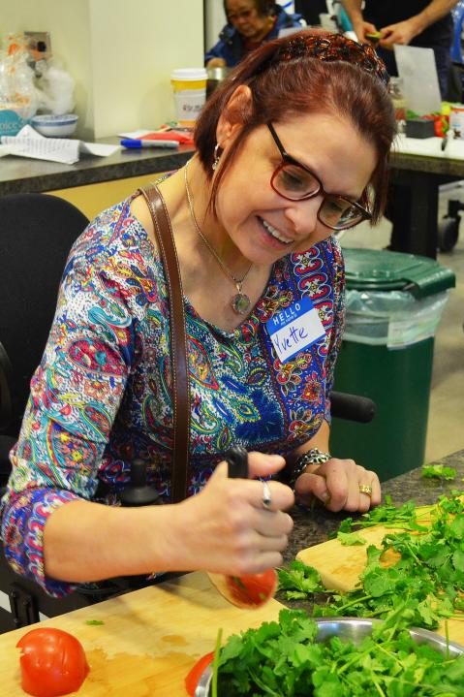
Prep a Meal Activity Idea
Prep a Meal Activity Idea At home At cooking class Follow a recipe? Understand sequencing of tasks Comprehension – words, pictures, font size Fine motor skills? Understand measurements? Ask for help? -Look for transferrable skills

Slide 56
The trouble with “What do you want to do?”
The question forces a response when people often have limited information from which to decide.
People may tell you things you want to hear.
Discovery isn’t about a job title or naming a job. It’s about the job characteristics (tasks, people, environment).
Doesn’t explore what’s important to the job seeker.
It’s limiting.
Many people have limited life experiences and a narrow vision of positive possibilities.

Slide 57
That’s unrealistic!
I want to be:
a doctor
an NBA player
a police officer
a fashion designer

Slide 58
Don’t take the “easy” route either
I want to:
work at Taco Bell
bag groceries
be a greeter
clean buildings

Slide 59

Thinking in Questions
Why did the person say a specific type of work? What is intriguing to them about that? Have they tried it before? Who is the influence in their lives? What kind of people do they like to be around?
What works and doesn’t work?
Don’t assume - investigate!

Slide 60
Thinking in Questions to Learn More
If someone says she wants to be a firefighter, what are some questions or things you’d like to know/investigate? What activities would you use to get the info?

Slide 61
“I want to be a fireman”
Questions
Why the interest in being a fireman?
Has she tried it before?
Does he know a firefighter?
What does she know about it?
What does he like about it the idea?
Activities
Home visit
Talk with family/friends
Go to fire station to explore
Talk with fireman
Do some job shadowing
Watch videos
Anything else?

Slide 62
Thinking in questions – support needs
What needs to be in place for her to be at her best?
What needs to happen for her to stay mentally and physically healthy?
What needs to be in place for him to be safe?
What type of environment do we need to find so they don’t get aggravated or stressed out.
How does she effectively receive instruction?

Slide 63
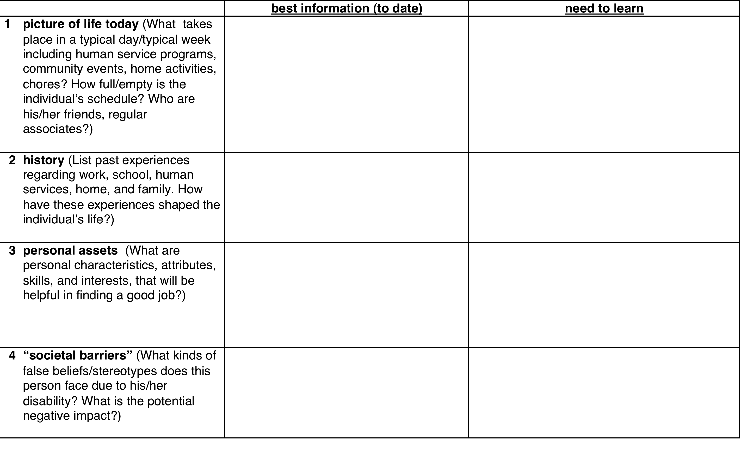
Information Organization form
Optional (SE Core Training Materials page)

Slide 64
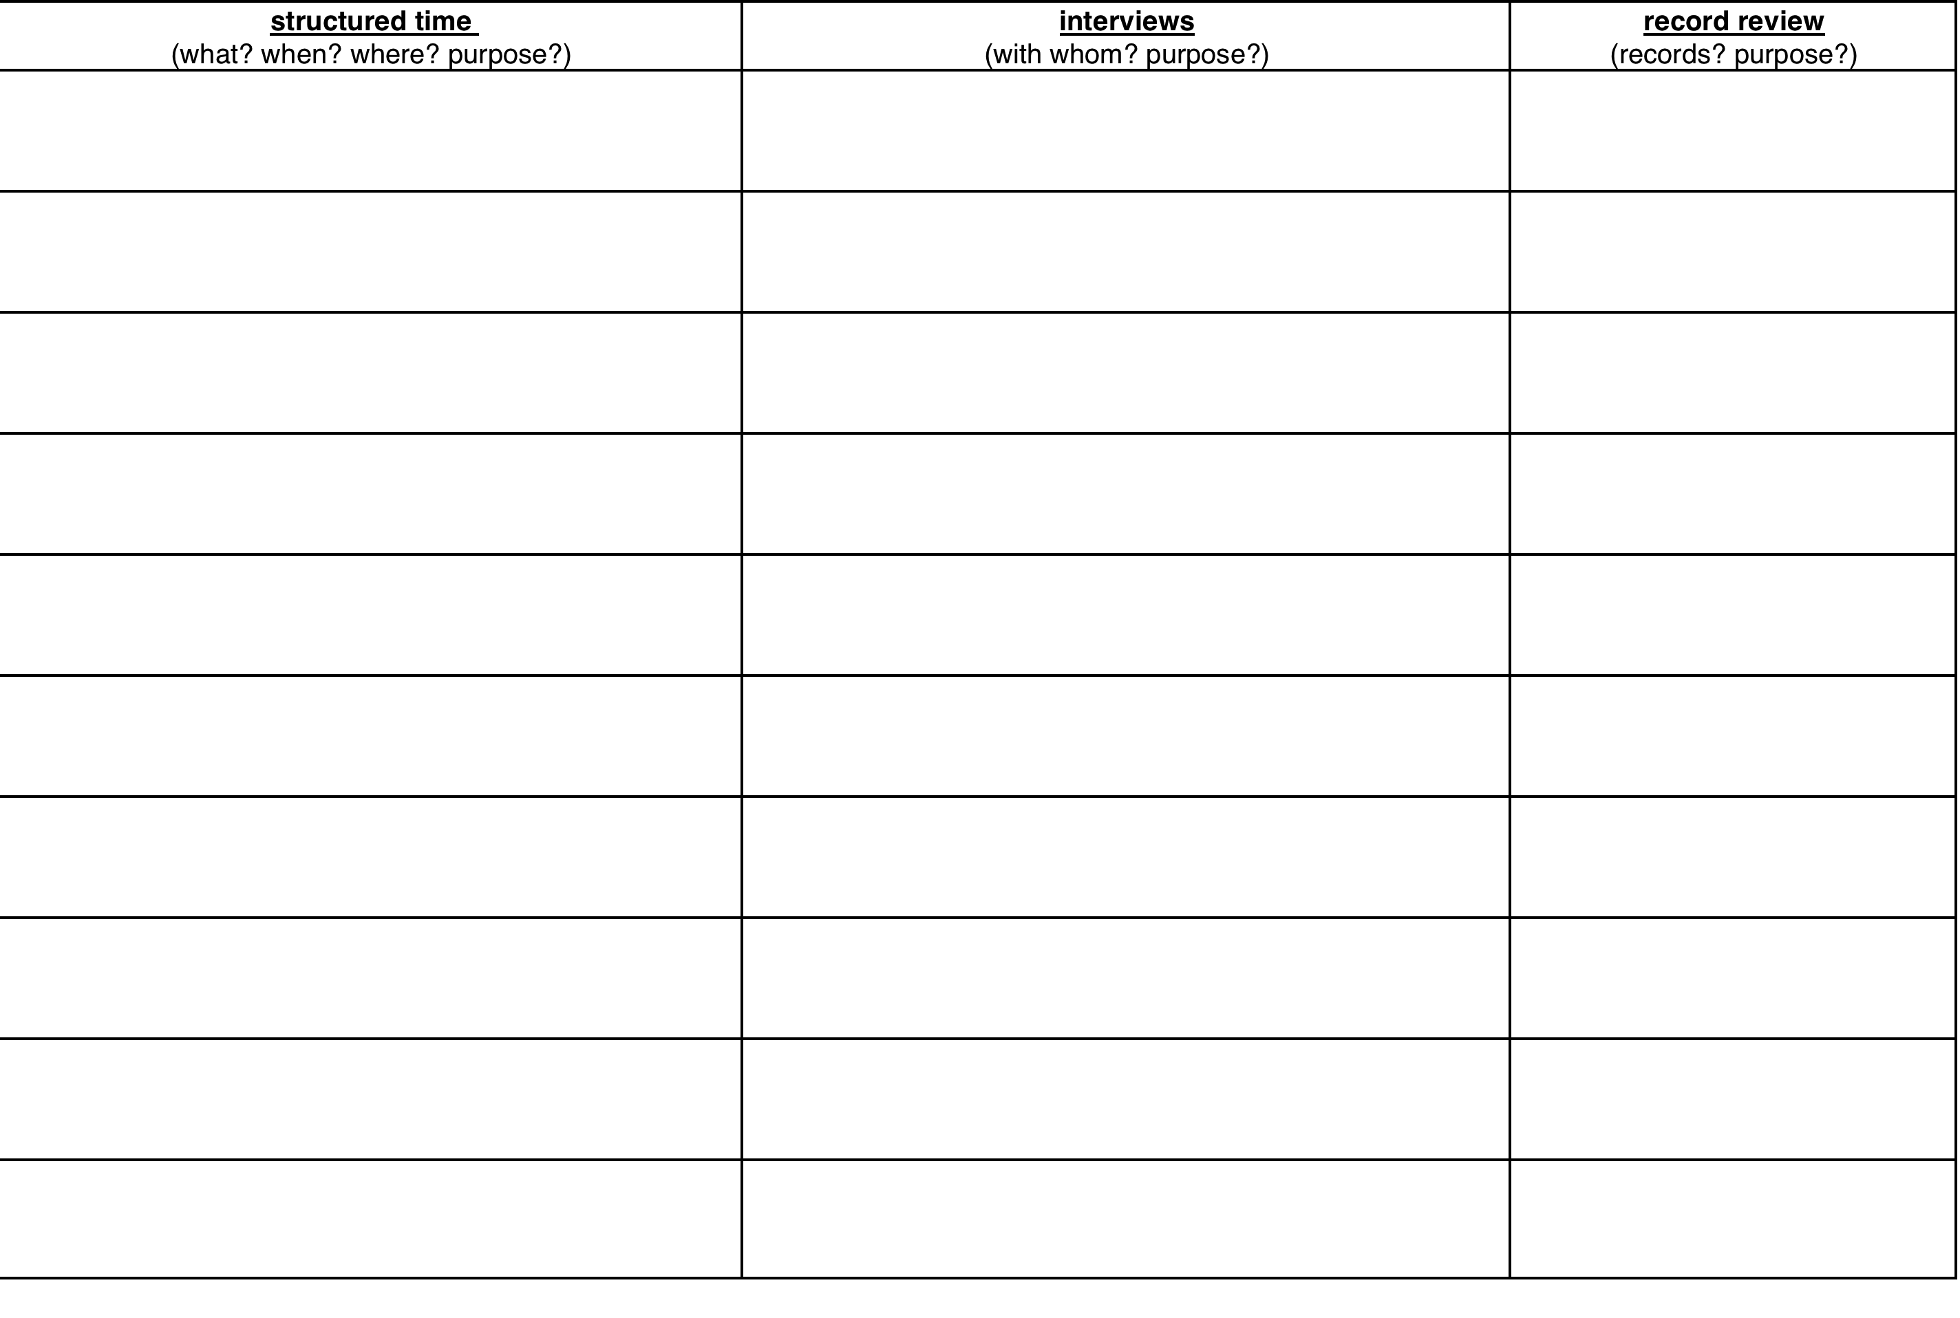
Ways to learn need information

Slide 65
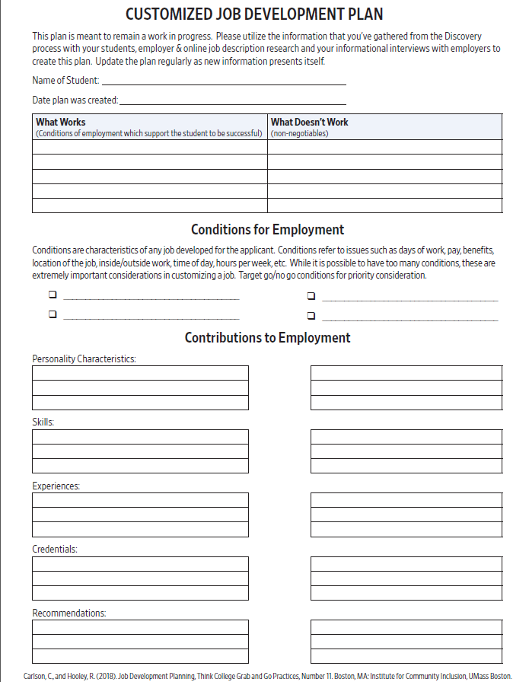
Customized Job Development Plan
Optional template for organizing information
SE Core Training Materials page:
“Example of Customized Job Development Plan”
-blank template
-filled out with job seeker Akemi to see an example

Slide 66
These forms can be helpful!
Not required
Ways to organize information
They are NOT structured, rigorous assessments
Discovery is all about learning, gathering information and then translating it into
What someone has to offer
What they prefer
What conditions will set them up for success

Slide 67
Randy’s story
Randy’s Story

Slide 68
RANDY – What was known
Worked at Food Lion as a bagger
Worked part time
Attended TRP on days off
Did sweeping and mopping at TRP
Organic brain disorder
Intellectual Disability
Autism
Limited language skills
Violent behavior
Lots of support

Slide 69
RANDY- What was learned
Needed a job with consistency
Job with predictability
Quality vs. quantity
Small group of people
Not a lot of interaction with variety of different people
Memorizes numbers
Likes to take things apart
Once learned something, knows it!

Slide 70
How to get from there to here?
Start with the familiar…
?
then move toward the novel.

Slide 71
Initial Meeting – How to Set Up
Where? Somewhere comfortable. Home, library, coffee shop, etc. (Familiar! His turf)
What to do? Introductions, explain SE process, set out expectations
What to ask? Tell me about your day? What do you enjoy doing? What do you do well?

Slide 72
Initial Meeting - What to Avoid
Your office
The ADT/other day program center
Just asking questions from the PCEP/Career Profile – NOT a form to fill out on the first day

Slide 73

Initial Meeting at Home
Met with Randy & his parents
He lived with them
He had limited language & they offered verbal information on his behalf
Explained process
Expectations – Lori, Family
Relationship building/trust

Slide 74
Things learned…
Background info, caring family
“Check your money, please”
Takes stuff apart (annoyance)
Attends TRP when not at work
Has pizza with family on Fridays
Goes to movies – only independent activity
What was learned? Where to go from here?

Slide 75

Starting place…Home/Garage
Why selected?
“He always…” can lead to finding hidden interests/skills
Familiar place
Common activity

Slide 76
What was learned
He has lots of things in garage to take apart.
ASK: Where does all this come from?
ANSWER: Neighbors bring it.
Discover – neighbor involvement
ASK: Does he ever put it back together?
ANSWER: Not often, mostly takes apart.
Likes routine of taking things apart.

Slide 77
What was learned continued…
Discover - His room is very orderly.
ASK: Is he orderly/tidy in general?
ANSWER: Randy always wants everything in its place & will put things back of out of order.

Slide 78

TRP
Why chosen?
Familiar
Observation opportunity
Talk to others who know him
It’s where he spends a great deal of time

Slide 79

What was learned at the TRP
Stays busy with cleaning.
Once he’s learned a task, he won’t learn another way.
“Check your money, please.” – still there
No interaction with others (Susan).

Slide 80
Ready for job development? NO
So, he likes to clean. Great! We can always find janitorial jobs!
BUT….
Ask more questions!
What talent or skill makes Randy unique to a potential employer???
All jobs are not created equal.

Slide 81
Thinking in Questions (Randy)
ASK: Why does Randy clean?
ANSWER: Randy likes to be busy. He likes to see the results of his work and things in the right place.
What we need to remember: It isn’t that Randy LIKES & WANTS to clean, it’s that this is the preferred option of the limited choices available. Learn what we can from this & seek something more fitting to Randy.

Slide 82
Remember the iceberg!
Randy cleans at the TRP.
He is a hard worker who wants to be busy and prefers to use his hands.

Slide 83
Thinking in Questions (Randy) Continued…
ASK: How does Randy learn tasks?
ANSWER: Modeling tasks. Once Randy has learned it, that’s how it will be. He won’t change method. Learned this from talking with Susan at TRP and family at home.
What I need to remember/important: On the job site, he needs to learn the correct way first; no room for correcting after a task is learned. Seek good instruction!

Slide 84
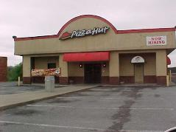
Pizza Hut
Went with family to eat
Observed family dynamics/social skills
“Check your money, please.”
What was learned? Stays with family, and they ordered for him.
Where do we go from here?

Slide 85

Movies
Why Selected?
Only place Randy went by himself
Part of his typical routine, familiar place
“Check your money, please.” Will he do this here?
Observation opportunity

Slide 86
What was learned from movie theater
Randy only says, “check your money, please” when someone is around who can explain what he means.
Knew routine of what to do at the movies (get ticket, sit in seat, quiet).

Slide 87
Ready for job development? NO!
So, he likes to go the movies. Great! I can always find a job as a ticket taker.
BUT….
Lots of people, need to converse, not routine, doesn’t use Randy’s unique skills, likely not consistent co-workers…
Ask more questions!!
All jobs are not created equal.

Slide 88
Remember the iceberg (Randy)!
He goes to the movies every Friday night.
Randy goes independently because he likes to watch movies. His preferred work conditions are totally opposite those of a movie theater.

Slide 89
Think in Questions
ASK: How can we know Randy won’t try to take someone’s money?
ANSWER: He only says, “check your money please” when someone is there to explain what he means by it.
ASK: How can someone do what needs to be done with unfamiliar people when he doesn’t talk much?
ANSWER: Needs to be shown (same every time).

Slide 90
Think in Questions Continued…
So, Randy should work with money?
ASK: What is it about this?
ANSWER: It’s not counting money or money itself he likes; it is the memorization of large numbers.
NOTE: THIS is a unique ability Randy has to offer.

Slide 91

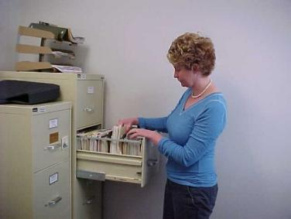
Record Review

Slide 92
Why Caution?
Balance need for information – diagnostic, health related, background, etc. with understanding that a lot of information may not be currently relevant.
You shouldn't ignore what's in a file, but you also need to get to know this person for yourself to see who s/he really is.

Slide 93
Putting it all together
Common themes
Not just one event
Evidence

Slide 94
Discovery = Translation
The finesse of discovery is to identify typical aspects of life and to translate those activities into Conditions for success, Interests toward employment and potential Contributions to be offered to employers.
Discovery is essentially an activity of translation.
Marc Gold & Associates©

Slide 95
What are you looking for?
Tasks
People
Environment

Slide 96
Randy summary
Ideal work tasks for Randy:
uses interests and skills in taking things apart
uses unique ability to memorize numbers
consistency and predictability
quality versus quantity
Ideal co-workers:
small group
mature
Ideal setting:
small business or defined workstation
industrial
not a lot of interaction with a variety of people

Slide 97
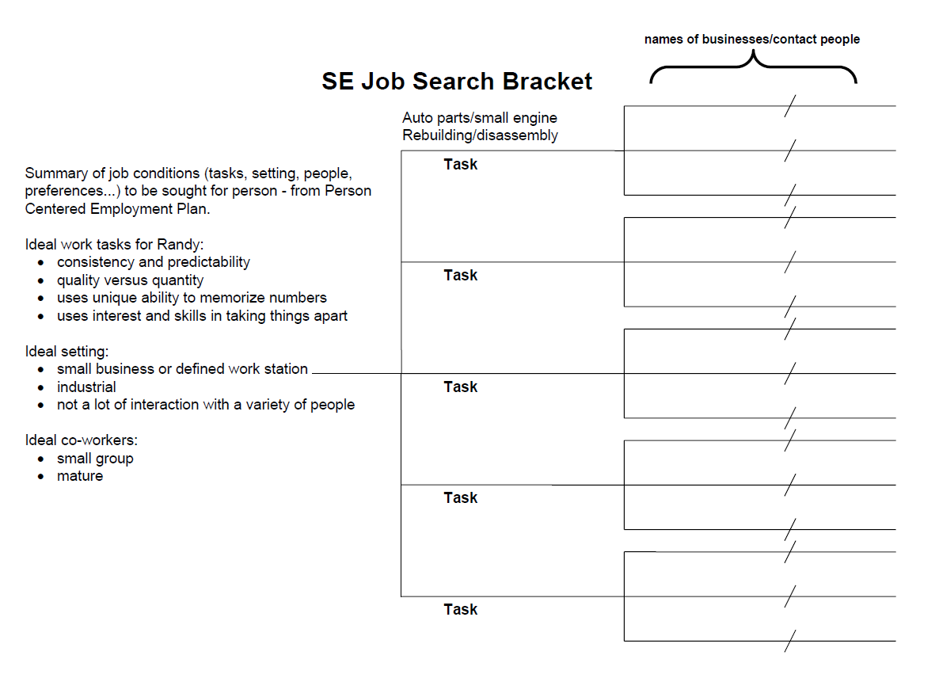
SE Job Search Bracket

Slide 98
What did you come up with?

Slide 99
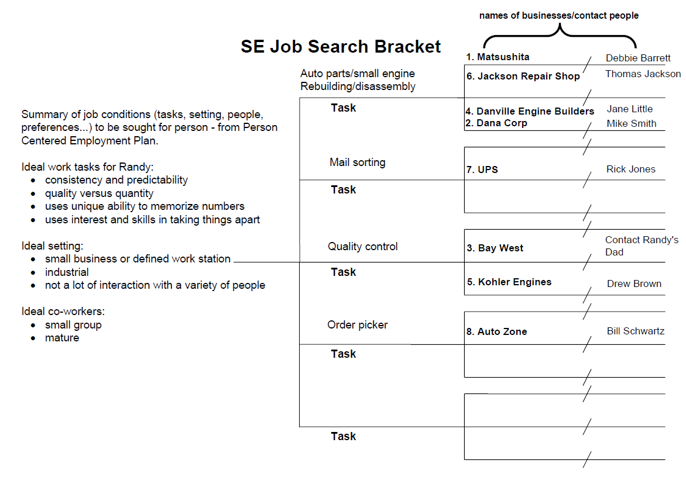
Job bracket Randy

Slide 100
Randy’s job after PCJS/Career Profile
Working in a factory taking things apart
Disassembly skills
Put in boxes marked by set of numbers
Memorization of long numbers
Works full-time with benefits
Regular schedule, well compensated
Works with 2-3 other men in his work area
Mature co-workers, not a lot of interaction with unknown others; natural supports
Takes vacations
No violent behavior

Slide 101
The Big Question
The Big Question?
Would Randy have come up with this job without this process?

Slide 102



Compare the jobs
Worked only when on the schedule - no consistency
Groceries needed to be bagged at a fast pace; other tasks when asked; no routine
Lots of people interaction – public & high turnover of co-workers
Needed a lot of support
Worked everyday, set routine regarding tasks & schedule
Responsible for tasks which utilized his competencies
Quality was important
Same people every day who knew him
Reduced support

Slide 103
Writing Product
Respectful
Plan to share with the job seeker and family/guardian
Meaningful
Useful
Descriptive

Slide 104
Writing Process
Have a good note taking/memory stimulating strategy.
Avoid interruptions.
Say it to someone else.
Take a walk.

Slide 105
Note Writing
Quality
Matters.
Be clear and precise.
Describe activities so there is no question as to what occurred.
Unclearly stated behavior/actions can and will be misinterpreted.
Provide enough description to ensure statements are informative.

Slide 106
The Importance of Description
Bob’s shy.
“Bob looked down at the floor when he spoke with the manager at Auto Zone.”
Sally’s happy.
“After we left Best Buy, Sally was smiling and talked about things she liked about the store (conversation with Joan about demonstrating laptops features, open/accessible store layout ,and its orderliness and cleanliness) on the way home.”

Slide 107
Proofread
The more time and distance you can put between your writing and proofreading, the more objective you will be.
Enlist someone else to proofread your work.

Slide 108

OVR Specifics

Slide 109
Discovery Person Centered Job Selection (PCJS)
Traditional SE
Receive authorization from OVR Counselor to begin Discovery/PCJS process.
Document each activity/meeting with “PCEP Activity Note.”
Talk with supervisor about how often you invoice
$80/hour: minimum 10 hours; maximum 20
Remember! This is when you spend time getting to know the individual in different aspects of her/his life. Spend time in different places, meet people who are important to her/him, review records. Spending quality time and learning from each activity is critical to get to know this person.

Slide 110
PCEP Activity Notes (Info to be learned for Person Centered Employment Plan)
Traditional SE
Complete one note per activity.
Submit all notes to your OVR Counselor at the end of each month (5th of next month at latest).
If Job Seeker has a Case Manager – should be sent to CM as well.
Must be turned in monthly – even if no contact was made. Create a note of attempts to contact.
These notes reflect how you are getting to know the individual in various aspects of their life.
Billable hours include time spent with or directly on behalf of the consumer

Slide 111
PCEP Activity Note
Traditional SE
Basic Information
Discovery Activity: State here exactly what you (the ES) have done with or for the job seeker on this day to get to know them better.
Results: What did you learn about the individual?
Next Steps: What else do you want to know or learn more about? How will you find the information? This section guides future activities. Include dates & places.

Slide 112
How to NOT write a note:
Job Seeker’s Name: Joe Smith
Discovery Activity: Met at Starbucks
Purpose: Start the PCEP
Results: He wants to work but can’t stand for long periods of time. Has his GED.
Next Steps: Finish PCEP

Slide 113
Career Profile
IPS SE
Receive authorization from OVR Counselor
Remember! This is when you spend time getting to know the individual in different aspects of her/his life. Spend time in different places, meet people who are important to her/him, and review records. Spending quality time and learning from each meeting is critical to get to know this person.
No notes are required to submit to OVR
Know how you will keep track of information!
The Career Profile is NOT intended to be a form you fill out in a Q&A meeting.

Slide 114
Basic Tips to Get Started Questions to Engage Job Seeker:
?
How did you get here today?
How might being employed change your life?
What would be the smallest or easiest 1st step for you?
When was the last time you felt good? What would it take to reach that again?
What do people say you are good at?
What do you think you are good at? What makes you unique?
What do you want life to look like in 3 years?
What activity have you noticed makes you lose track of time?
Imagine that you are truly confident that others will support you. What might you do?
When do you feel most like your true self?
What jazzes you about going to work/school?
So, tell me about your morning.
If you could talk to your future self, what would you say?
With whom do you like to spend time?

Slide 115
Person Centered Employment Plan and Career Profile
It’s More than Just a Form.
It’s What You Know About the Person & is the start of your Job Development PLAN.

Slide 116
IPS - Career profile & Job Search Plan
IPS SE
Career Profile and Job Search Plan are written after you’ve completed the initial phase.
Turn into OVR along with an invoice for $750.
This plan should reflect all that you’ve learned about the individual and be a plan to guide job development.
It’s more than just a report.

Slide 117
Career Profile
IPS SE
Look at the Career Profile.
Look at the Tip Sheet – Remember, the answers to these questions will guide how you fill out the Profile.
When we talk about the headings on the PCEP, the same information is relevant to the Career Profile, just asked in different ways…but you have to know the info!

Slide 118
Traditional - Person Centered Employment Plan
Traditional SE
PCEP is written after you’ve completed the Discovery/ Person Centered Job Selection phase.
Turn into OVR along with an invoice for:
$800 IF approved within 45 days of begin service date on authorization
$400 IF approved 46+ days of begin service date
(If job seeker has a Case Manager – be sure CM receives a copy as well)
This plan should reflect all that you’ve learned about the individual and be a plan to guide job development.
It’s more than just a report.

Slide 119
Person Centered Employment Plan (PCEP)
Traditional SE
General Info: Who is this person?
Background information we (reader) need to know?
Family or other key relationships?
Where does this person live? Who does he/she live with?
Note other community involvement.
How is work going to improve the quality of this person’s life?
How is disability going to impact employment, what will need to be addressed?
See Randy’s PCEP on SE Core Training Materials page – OVR Documentation & Process/Traditional Documentation Example Sets

Slide 120
Employment History
Include in this section any paid work, volunteer jobs, school transition jobs, or other work experiences. Consider tasks, hours, environment, people, & employer.
If job seeker has NO past work experience, focus on tasks or chores done on a routine basis.

Slide 121
Employment History cont.
Be sure to address:
Jobs that worked well and why? Job that did not work well and why?
Describe what has and has not worked and WHY specific job sites worked/did not work for the person.
Be creative in finding out why jobs have/have not worked well for the person, what was it about this experience(s) that made the difference?

Slide 122
Interests
You are identifying the “spark.” What interests this person?
What does he/she choose to do or do well?
How does the job seeker spend his/her time?
What do other people say he/she enjoys doing?
Be sure to include how you (ES) learned about these interests. Discuss your involvement in the community with the job seeker and any creative strategies used to gain this information. You need to offer enough information to back up that this truly is a real interest of the job seeker.

Slide 123
Skills
What is this person good at? What skills does he/she possess?
What kind of things does he/she do regularly?
Be sure to include how you (ES) learned about these skills. Discuss your involvement in the community with the job seeker and any creative strategies used to gain this information. You need to offer enough information to back up that this truly is a real skill of the job seeker.

Slide 124
When is this person at their best?
When is this person at their best?

Slide 125
Job Tasks
Skills and interests translate into what job tasks the person can and will be able to do.
Be sure that the task matches skills and interests. Just because someone has the skill to stock shelves doesn’t mean he or she has any interest to do so.

Slide 126
It’s OUR job to be the Translator
It’s OUR job to be the Translator.
Skills + Interests Tasks

Slide 127
Desired employment considerations & rationale for each
What needs to be looked for in a work environment? (lighting, noise, pace of business, location, size, etc.)
What needs to be looked for in culture of workplace? (people/personalities, quality versus quantity, tight or loose on method of how work is done, outgoing, quiet, etc.)

Slide 128
Desired employment considerations & rationale for each (cont.)
Preferences – what he/she would like to be in place & deal breakers – non-negotiable characteristics that must be accounted for
Need to explain these characteristics: Joe is not going to be able to work after 7:00 pm due to taking his medication at this time and the medication makes him very drowsy. His doctor has stated that a time change for this medication is non-negotiable.

Slide 129
Learning Style/Teaching Tools
How does this person learn best?
How do you plan to facilitate learning on-the-job while incorporating the people who typically teach new employees?

Slide 130
Ideal number of hours per week
State your opinion on an appropriate number of work hours AND how this decision was made.
You need to present a clear idea of how many hours per week this person wants to work prior to going out to looking for a job.

Slide 131
Plan of Action Part 1
See Suggested
“Job Search Bracket”
I. Job Possibilities – based on identified skills/interests & tasks. List name of business and type of work
List potential places of employment by name (and contact person if identified) that have need of the skills/tasks the job seeker has to offer & that fit the preferred characteristics of a job.
List the tasks you will be looking for within that company.
This list will come from a job planning meeting. This is your starting place for job development once authorized to begin.

Slide 132
Plan of Action Part 2
See Suggested “Representational Considerations” form
II. Representational Considerations
Include role of Employment Specialist. This is the area to address the plan for job development—who will make employer contacts; how will disability info be addressed, etc.
State how you are going to represent the job seeker
Discuss how the individual’s disability is going to be addressed to potential employers - what can you say? What can’t you say?
Permissions for potential disclosure.
How will you describe the impact of disability in functional terms?

Slide 133
Plan of Action Part 3
III. On-the-Job Supports
Role of Employment Specialist, natural supports, training supports – how typical people who train will be involved, other supports.
Explain what type of supports will be expected at the job site (examples: facilitating relationships, following natural prompts to tell time, working with small group of consistent co-workers, initial instruction using the time clock, etc.).

Slide 134
Plan of Action Part 4
IV. Other Support Services
Such as rehab tech, SCL, supports needed for transportation, etc.
List here any support services the job seeker has/will need that relate to him/her being successful at work (residential services, case manager, PT appointment every other week, Therapist appointment every Wednesday, etc.)
Will the job seeker need an accommodation? Describe what may be needed and who may be able to help figure out the details.

Slide 135
Plan of Action Part 5
V. Plan for fading
Plan for individual to be independent on the job site.
Identify needed natural supports (people, prompts, orientation, etc.)
Identify ES initial role on the job site
Plan for sharing job seeker’s learning style, suggested teaching techniques, optimal methods of communicating information, etc.

Slide 136
Other Important Information…
Describe any other necessary information here that you didn’t feel was appropriate to place anywhere else.
Examples: criminal background, safety concerns, unique aspects of person not listed previously, etc.
You don’t have to list anything here, only if needed.

Slide 137
Final Sections
Signature & Contact Information
Total time spent – This DOES NOT include time spent writing the report. This is a total of all time spent doing PCJS (activities with and on behalf of job seeker)
Addendum/Amendment/Modification
To be completed if and when needed AFTER discussing with OVR Counselor.

Slide 138
Questions to Consider when doing a PCEP/Career Profile
Have all of the questions (including italicized questions) been answered?
Does the person seem familiar to you as you read it?
Is it easy to read?
Have interests/skills been explored?
Is there justification of what was learned/planned?
Is there a clear plan for Job Development?
Supports clearly defined?
Do you still have questions after reading this or need more information?

Slide 139
Reviewing PCEP/Career Profile
Ask a co-worker to review your PCEP/Career Profile and see what they think of the previous questions
Ask the individual/family to review the PCEP/Career Profile and see if it sounds like you’ve captured who he/she is or if there are areas which still need exploration

Slide 140
Communication is key
Activity notes must be turned into OVR (non IPS)
PCEP should also be turned into Case Manager
IPS requires routine meetings between ES & VRC, ES & treatment team
Other SE programs should look at similar practice

Slide 141
a keeper of hope
“One of the biggest problems has been the low expectation of providers… Until I was connected with a ‘keeper of hope.’ He had hope for me when I didn’t have it for myself. This (kind of relationship) shouldn’t happen by accident - it should happen by design.”
J. Rock Johnson

